Slide 1
Discussion on Single-Use Plastics Ban in commercial establishments Sept 05, 2023, Board of Supervisors Meeting Charlestown Township

Slide 2
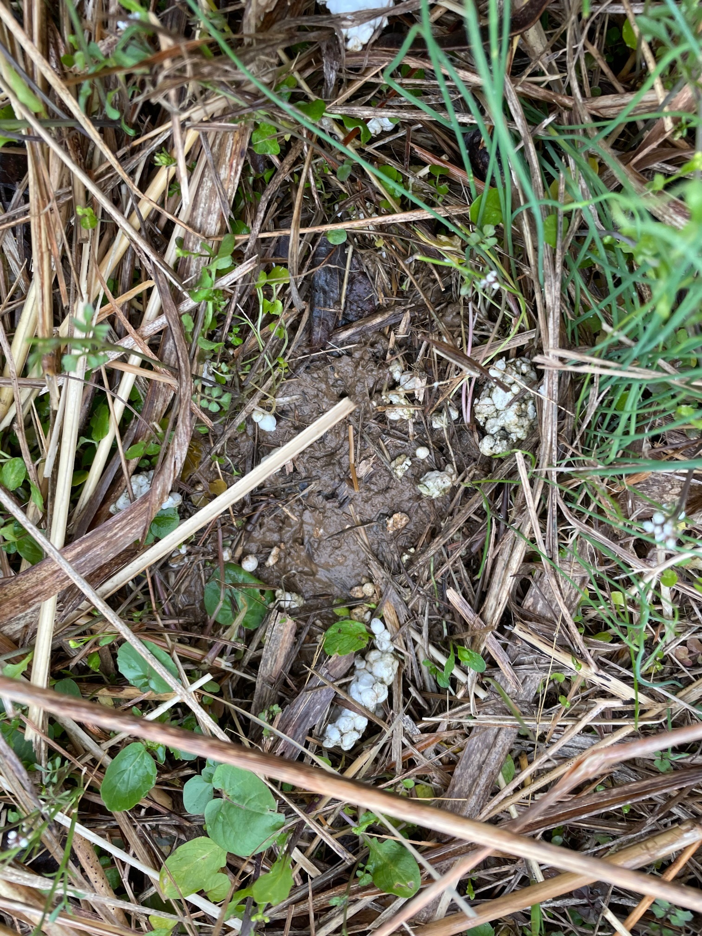
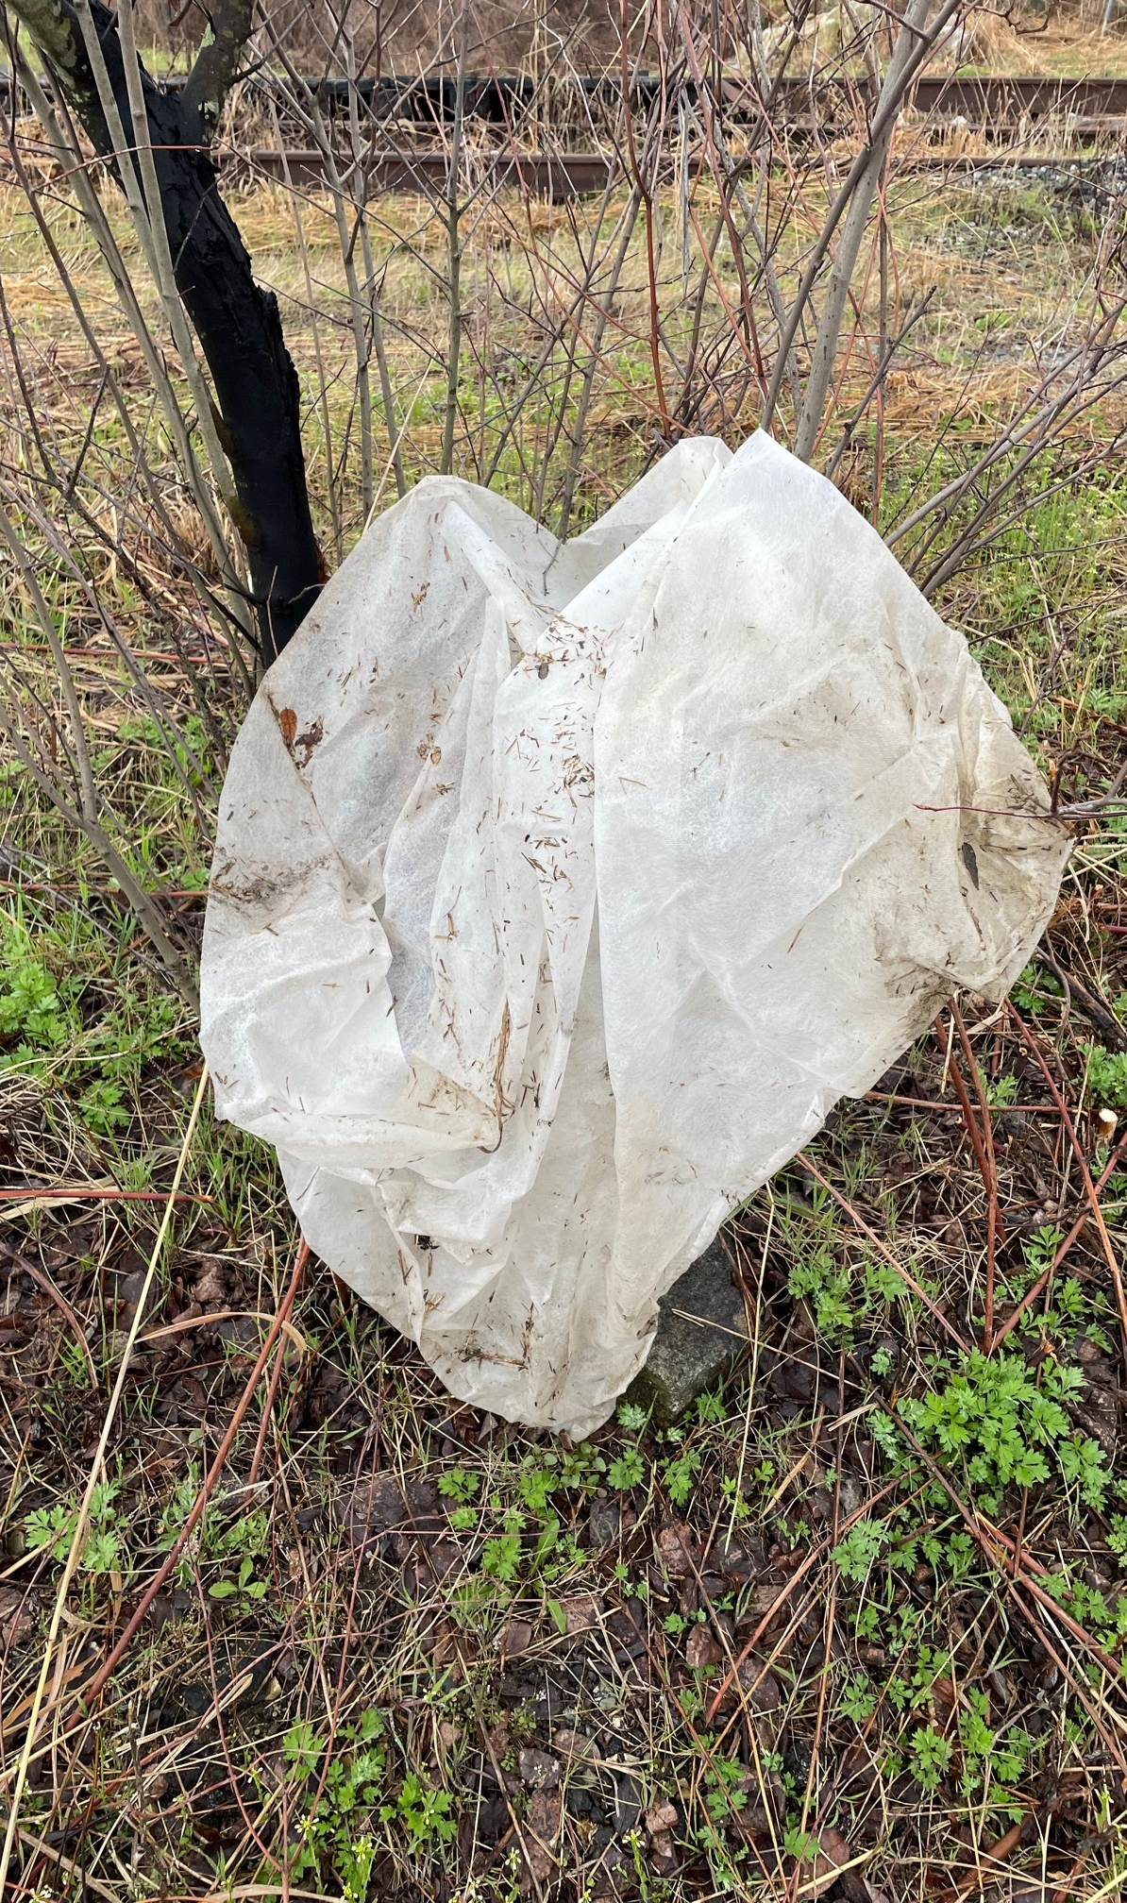
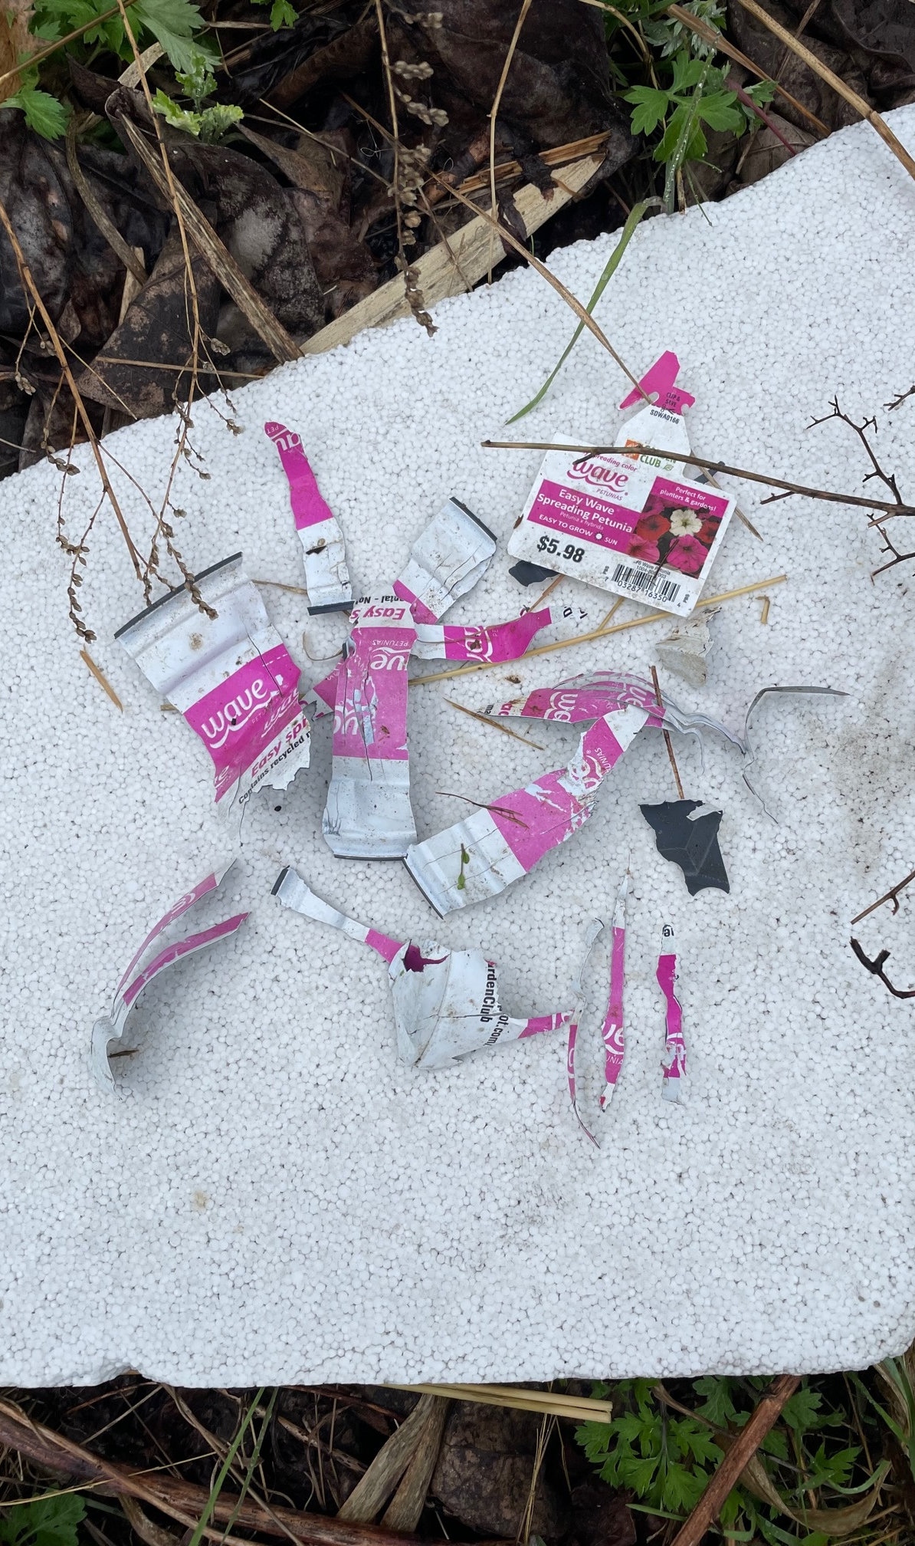
What’s the big deal with Single-Use Plastics (SUPs)?

Slide 3
Here’s the problem….
There is no “away” when it comes to single use plastic: in a landfill, incinerator, or in our environment, plastic does not biodegrade; instead, it breaks down turns into tiny pieces of plastic called microplastics and nanoplastics
Studies suggest we ingest 5 grams of plastic, or about the weight of a plastic bag, every week.
Nanoplastics have now been found in our immune system, blood, lungs, and brain tissue. The smallest nanoplastics in one study killed zooplankton within 24 hours. The fish who ate them had altered feeding behaviors (swam slowly, overshot prey), and had plastics in their brains.
Plastics always have toxic chemicals in them that give them their useful qualities, and these toxins begin leaching as soon as they are in the environment due to heat, light, movement, abrasion, wind, other vectors.
Microplastics: PATCH Article
conducted a study on 53 waterways in PA and found microplastics in all of them
Studies published in 2021 and 2022 by the USGS and Delaware River Basin Commission found microplastics in all the Delaware River water and sediment samples.

Slide 4
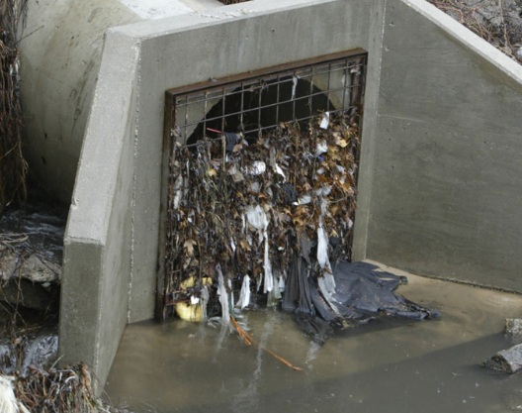
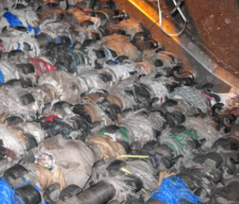
Here’s the problem….(contd.)
Plastic bags clog stormwater infrastructure and can greatly increase the damages from flooding and heavy rainfall
Plastic bags tangle recycling machinery, adding thousands of hours of work time, substantially raising the cost of recycling
Tackling plastic pollution = fighting climate change
Banning types of single-use plastic reduces demand for natural gas, new fracking wells and pipelines, and can help reduce a major source of emissions
Clogged stormwater drain
Plastic tangled in machinery

Slide 5
Why now?
Plastic bags and straws do not recycle and microplastics are now in our water, animals, food, air, and even in our bloodstream
Our neighbors – 22 townships and boroughs in PA have successfully passed/ implemented single-use plastic restrictions
Increased consumer awareness and support for environment friendly actions
Reusable and Biodegradable alternatives available to replace single use plastics
Notes:
Why and Why Now? Another way to frame this is what took us so long? On average, Americans get 12 minutes of usage out of plastic bags before throwing them in the garbage, where they don’t decompose for at least 450 years. Only 5-10% of plastic bags will ever be recycled.

Slide 6
Neighbors that have already taken action
Many local cities and Townships have already implemented plastics bans, including:
Borough of Ambler | City of Pittsburgh
Cheltenham Township | City of Philadelphia
Borough of Doylestown | Radnor Township
Easttown Township | Solebury Township
Haverford Township | Borough of Swarthmore
Lancaster Township | Tredyffrin Township
Lower Merion Township | Uwchlan Township*
Upper Merion Township* | Borough of West Chester
Upper Moreland Township | West Goshen Township
Borough of Media | West Norriton Township
Borough of Narberth | Whitemarsh Township
*On Sept 12, 2022, Uwchlan Township passed one of the most comprehensive ordinances to date in PA, a cause championed by their Board of Supervisors.
*Upper Merion includes the commercially dense King of Prussia mall, showing that the ordinances can be done in heavily commercial areas.

Slide 7
Considerations for restrictions on SUPs in Charlestown Township
Businesses no longer distribute single use plastic bags, plastic straws, plastic stirrers and Polystyrene containers
Offer plastic utensils only on an “as needed / as requested” basis
A minimal fee for paper bags as a replacement to plastic bags. Encourage customers to bring their own bags.
Exemptions will apply to certain plastics deemed necessary for business operations, such as:
Bags used to package bulk items such as fruit, vegetables, nuts, grains, or candy; OR
Bags used to contain or wrap meats or fish; to contain or wrap frozen foods; or to contain unwrapped prepared foods or bakery goods
* Some establishments (PJ Whelihan’s, Dunkin Donuts) have already accommodated ordinances in other towns

Slide 8
Next steps
Businesses interview and compile questions/concerns
1
Work out details of the Ordinance implementation including recommendations for Communication to residents and businesses, and Enforcement
2
Secure approval from Board of Supervisors to move ahead with creating the ordinance
4
Present findings and recommendations back to the Board of Supervisors. Discuss any resolutions to potential concerns raised.
3

Slide 9
Questions

Slide 10
Appendix
Why not just switch to paper bags?
Why is the Ban + Fee Combo so important?
Addl info on Plastics Pollution

Slide 11
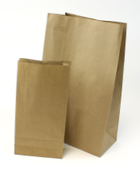
Why not just switch to paper bags?
Only banning plastic bags turns the millions of single-use plastic bags used in our township annually into millions of single-use paper bags.
And paper bags have their own environmental impact...
It takes more water and energy to make paper than it does to make plastic
While more easily recyclable, there’s no guarantee bags will actually be recycled
Paper bags often made of virgin trees; cutting down these trees/forests impacts how much CO2 is absorbed from the atmosphere
Paper weighs more than plastic, resulting in impact on shipping weight and increase in carbon emissions by haulers

Slide 12
Why is the BAN + FEE combo so important?
This Ban+Fee ordinance is called a “second generation” ordinance as it includes both the ban and the fee for paper bags. Research by multiple sources (see links) demonstrates this model to be the most impactful at reducing single-use plastic waste.
In Los Angeles, CA, a ban plus a $0.10 fee resulted in a 94% reduction in single-use plastic bag usage. Research has shown that the larger the fee, the greater the reduction in paper bag use
Once educated and implemented, businesses may benefit from the fee.
The fee for paper helps the business offset any additional costs for the price increase from plastic to paper, and in some situations the business makes more money by offering the paper due to the fact they had been giving out plastic bags for “free”
With the fee in place those costs are instead incurred exclusively by the buyer of the bag, which is 100% avoidable if you skip the bag or bring your own
Simply put: The Ban+Fee model works. Studies from multiple counties, US states, and countries support this finding.

Slide 13
Why is the BAN + FEE combo so important?
According to a 2018 study published in the American Economic Journal: Economic Policy, fees are more effective than bonuses at curtailing the use of plastic bags. Looking at data from various grocery stores, Tatiana Homonoff found that a $0.05 fee on disposable bags generated a 42 percent decrease in plastic bag usage, but a $0.05 bonus for using reusable bags had almost no impact on consumer habits. (Link: https://pubs.aeaweb.org/doi/pdfplus/10.1257/pol.20150261)
In 2019, a study was conducted in England on their bag fee which showed that, “all age, gender, and income groups in England substantially reduced their plastic bag usage within 1 month after the charge was introduced, with interviewees highlighting the ease of bringing their own bags…. Increased support for the plastic bag charge in turn predicted greater support for other charges to reduce plastic waste, suggesting a ‘policy spillover’ effect.” (Link: https://pubmed.ncbi.nlm.nih.gov/30863332/)

Slide 14
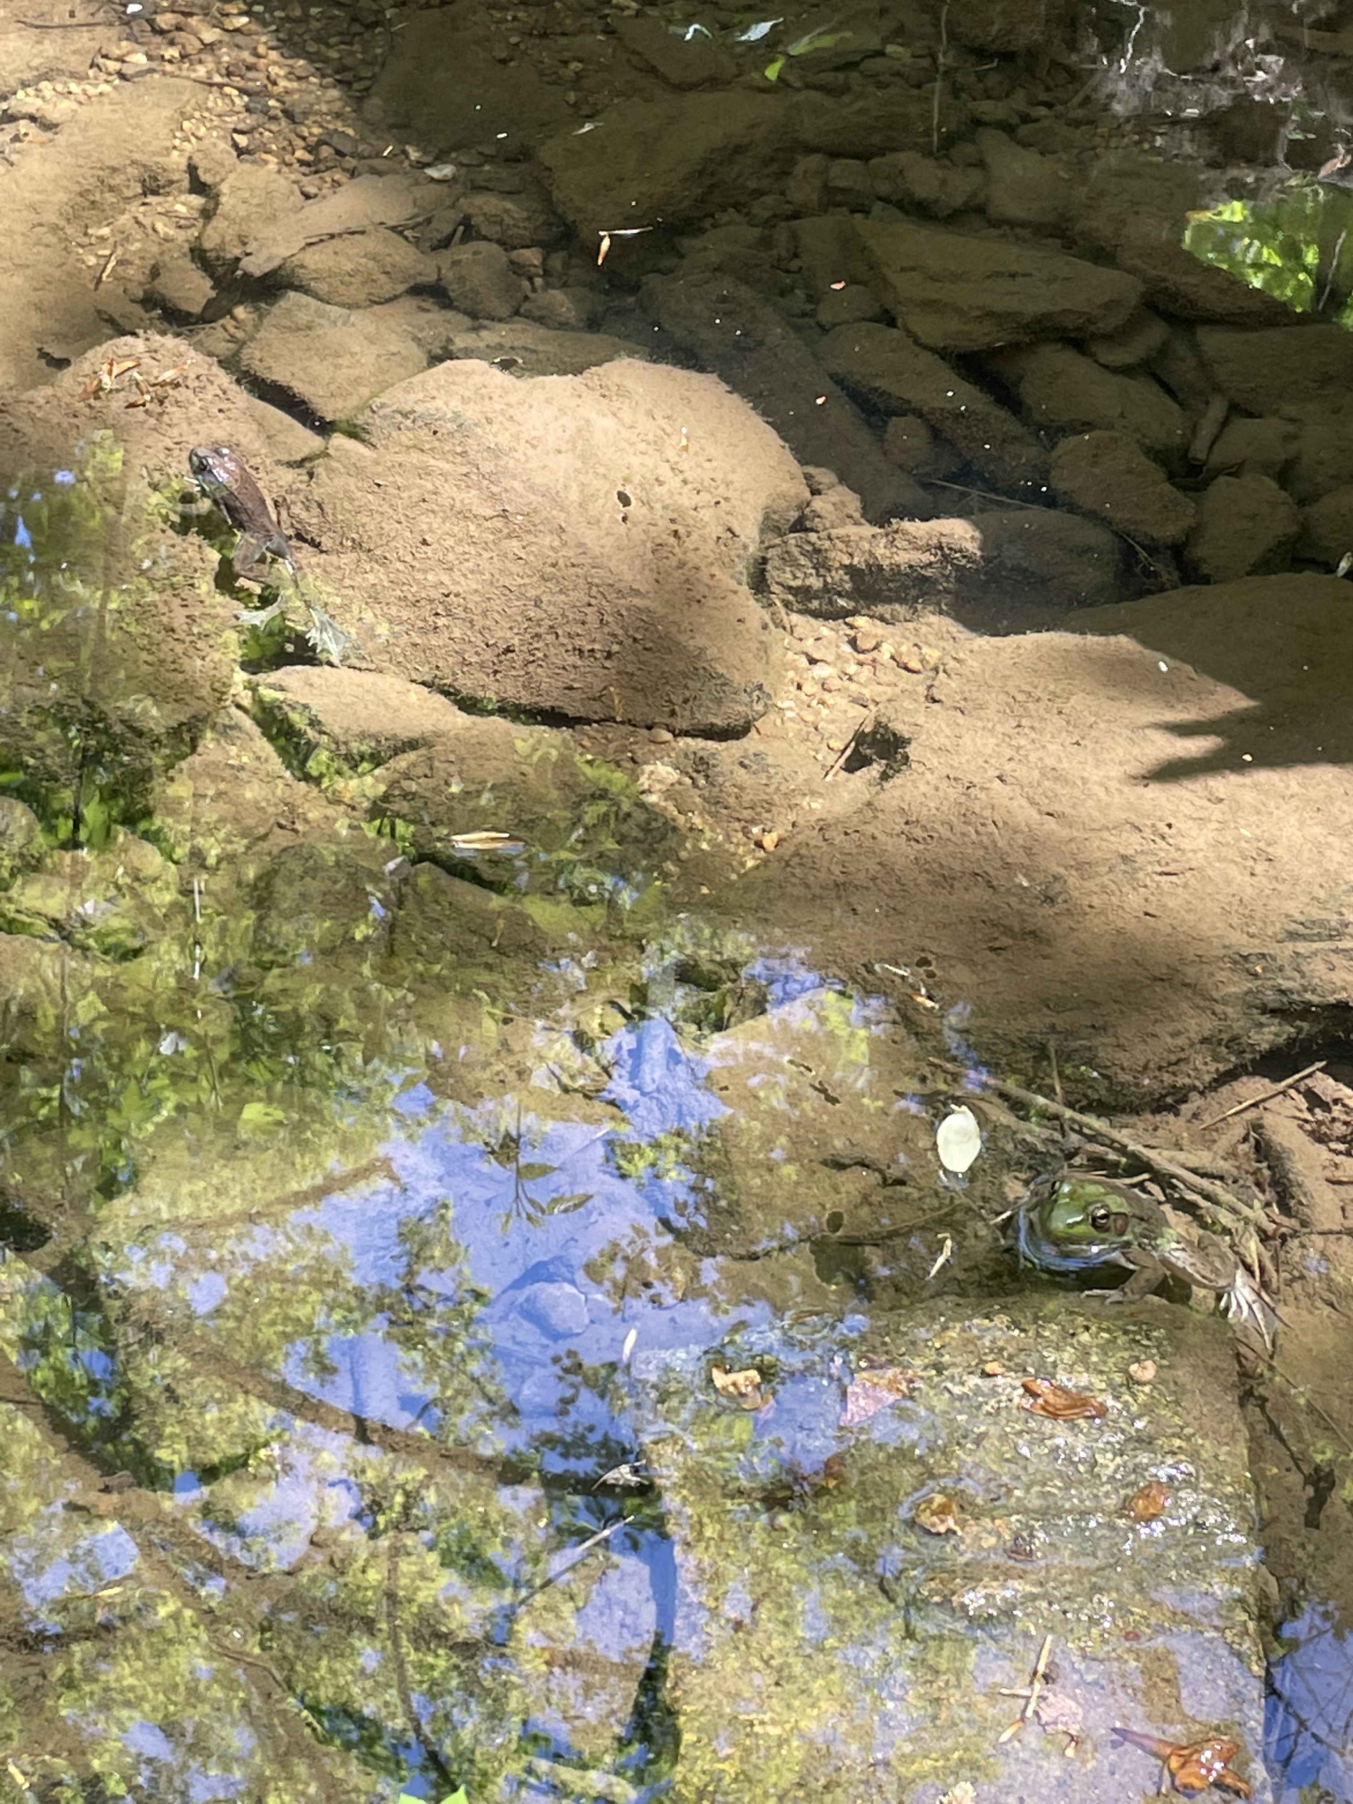
Macroplastics and microplastics are collecting in the sediment, banks, vegetation, and water of streams and rivers – more than in the Ocean.
Pickering Creek, of which Pigeon Run is a tributary, has its headwaters in Charlestown, and was designated a High Quality stream by the PA DEP
Valley Creek watershed is designated an Exceptional Value stream.
French Creek at Charlestown Park is designated High Quality, but it is a southern headwater of French Creek which is Exception Value further north.

Slide 15
“It is Raining Plastic” Wetherbee et al., 2019, USGS Report
Data from five years ago – microplastics are 4% of the particles in the earth’s troposphere
Brahney, et al, 2021, PNAS

Slide 16
Are plastics a problem?
According to Galloway and Lewis 2016 in PNAS: Proceedings of the National Academy of Sciences of the USA:
“There are certain human environmental perturbations so major that they are capable of destabilizing the earth’s normal function at a global scale. These so-called planetary boundary threats include climate change, ozone depletion, and ocean acidification. Emerging as a novel addition to this list is the vast quantity of discarded plastic waste that is accumulating in the oceans on an unprecedented scale, where it breaks down to form microscopic and nanoscopic fragments, or microplastics.”

