Slide 1
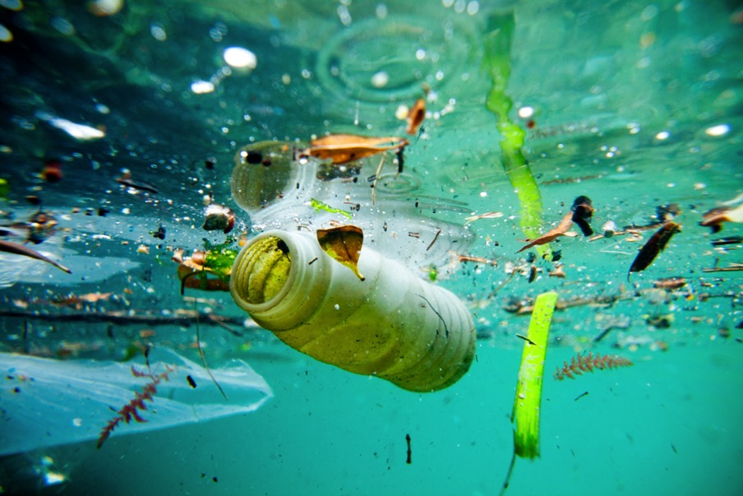
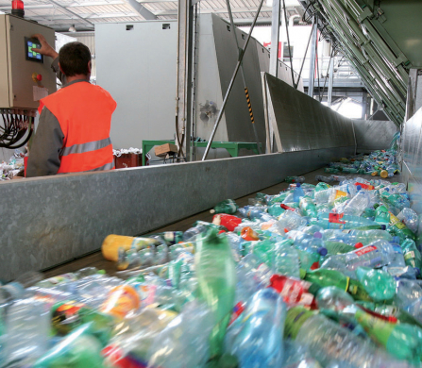
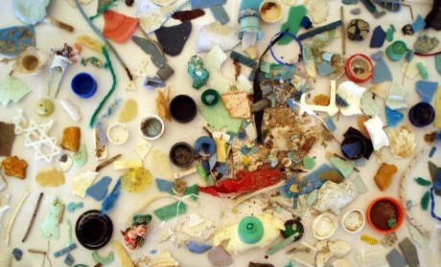

Plastics in Our Bodies and in the Environment
National Geographic
Carol Armstrong, Ph.D.
Mnem.np@gmail.com
January 28, 2020
©Veolia photo library-A. Duclos
NOAA
National Geographic
Notes:
Hi, my name is…. and I’m a Master Watershed Steward Volunteer with the …… County Penn State Extension Master Watershed Steward Program. Thank you for having me today and giving me the opportunity to talk about this important issue.

Slide 2
You know the problems of plastics…
From 1950-2017, only 9% were recycled world wide (National Geographic).
In 2015, ab 55% of global plastic waste was discarded, 25% incinerated, 20% was recycled (U. Oxford).
Developing economies have little capacity to recycle -almost 0%/yr.
In China and Southeast Asia, 4 to 12 metric tons enters the oceans every year by informal dumping and from streams/rivers. (D’Ambrières, Field Actions Sci Rep 2019). How much are WE responsible for dumping in the rivers/oceans?
The high demand for plastics in Asia led to exportation to Asia from other continents. China and increasing number of Southeast Asian countries are banning post-consumer plastic importation.
The production of ‘bioplastics’ is about 1% of global plastics (U. Oxford). Must be biodegraded with high heat by special facilities, uv & moisture.
Notes:
Blue data from AAAS Science

Slide 3
How Long until It Is Gone? (projections)
Depends on the amount of moisture and heat present
Cardboard box and apple core – 2 months
Cotton shirt – 2-5 months
Wool socks – 1-5 years
Waxed carton – 5 years
Cigarette butt – 1.5 to 10 years
Plastic grocery bag – 15-1000 years
Paper cup – more than 20 years
Nylon – 30-40 years
Tin can – 50 years
Tires and rubber shoe/boot soles – 50-100 years
Alkaline batteries – 100 years
Aluminum can – 200 years
Plastic beverage holder – 400 years
Disposable diaper and plastic bottle – ~500 years
Fishing line – 600 years
Foam buoy, styrofoam cup – practicably, never
Notes:
Plastic is extremely persistent in the environment. Here is a chart that folks have probably seen before, showing how long it takes (or is projected to take, since widespread plastics are only 60 years old) for various types of trash & plastics to break down in the environment. Note the dramatic difference between wool socks, at a couple of years, and the 450 years anticipated for the decomposition of a plastic bottle. Graphic from NOAA
Again, if plastic has only been in use since the late ‘40’s, we can really only project that it will break down in 450 years, or rather, break up, since plastic items never ‘decompose’ as they are not made of organic molecules such as carbon, oxygen and nitrogen. They just continue to break into smaller and smaller pieces.

Slide 4
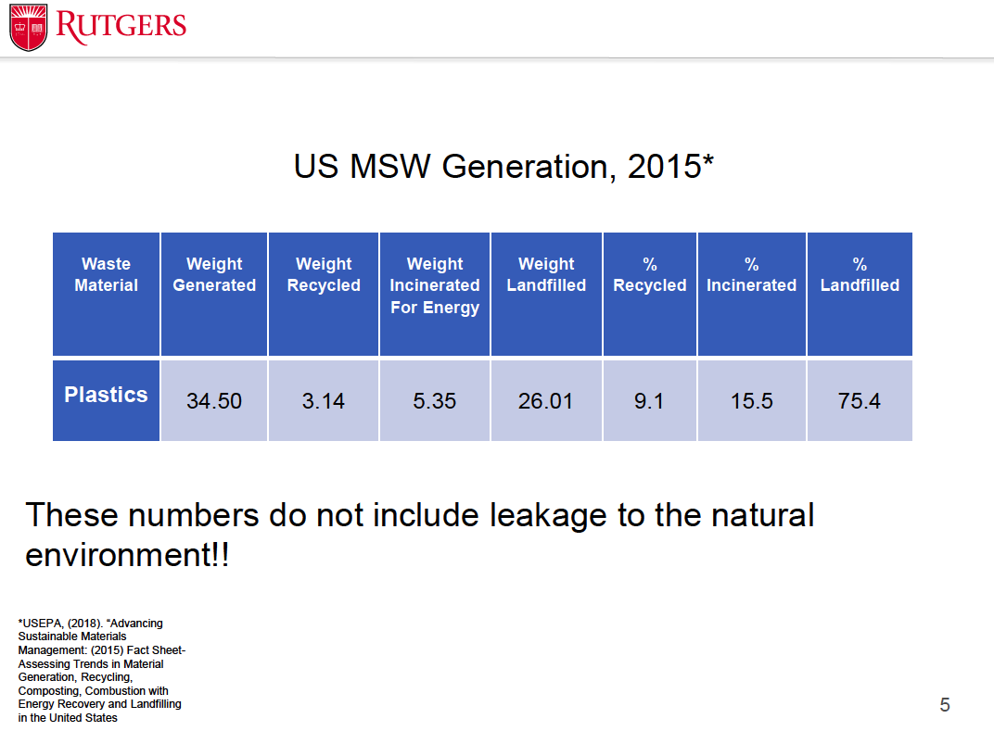
The % incinerated varies greatly. E.g., in Harrisburg, all is incinerated. Large recycling companies harvest the methane directly to gas turbines for burning and creating electricity.
MSW: municipal solid waste. Given in millions of tons.
Notes:
MSW = municipal solid waste

Slide 5
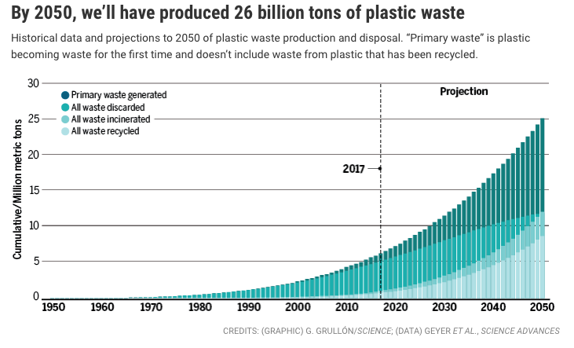
~ 8300 million tons of plastic produced since 1950; 6300 million tons of waste.
AND
300-400 million tons of plastic are manufactured every year.
AND
In the next 30 y, 4 x more plastic waste than ever before (AAAS, Science, 7/19/17).
Guglielmi G, Science, 7/19/17

Slide 6
The Clock Is Ticking
“Why do you [work] like you’re running out of time?…
Do you support this [earth]? Of course. Then defend it”
(A. Burr and A. Hamilton in Hamilton, by L-M Miranda)
Every hour - Americans use 2,500,000 plastic bottles, which is the most prolifically produced consumer good. Only 14% of are recycled.
In a week - 10 billion plastic bags used worldwide. The average American family takes home almost 1,500 bags a year.
In a lifetime – the average American will personally throw away 600 times his/her bodyweight of plastic.
Exfoliating washes and toothpaste contained polyethylene microbeads. Microbeads were outlawed for sales as of 7/2018, and producers had until 7/2019 for time for safety testing of products that were both cosmetics and non-prescription drugs. Plastics and other toxic chemicals continue to to be sold in detergent (polyethylene,polycarboxylates, quaternium 15, xylene sulfonate). You must read labels.
93% of Americans test positive for the presence of BPA in their bodies (CDC study from 2003-2004).
Sourced from the University of Tennessee, Dept. of Forestry, Wildlife and Fisheries
Notes:
To show you the extent of the plastic in our lives, the University of Tennessee prepared the following statistics…
https://19january2017snapshot.epa.gov/sites/production/files/2017-01/documents/microplastics-in-freshwater-environment.pdf

Slide 7
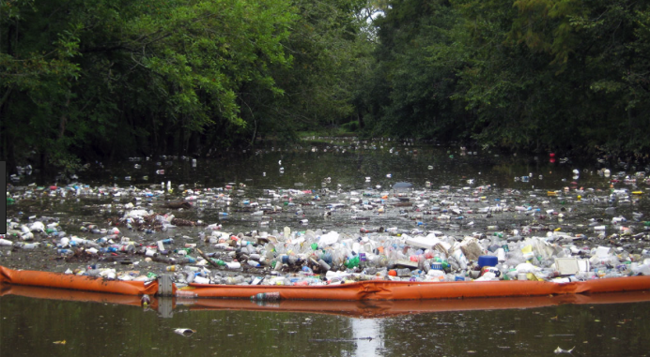
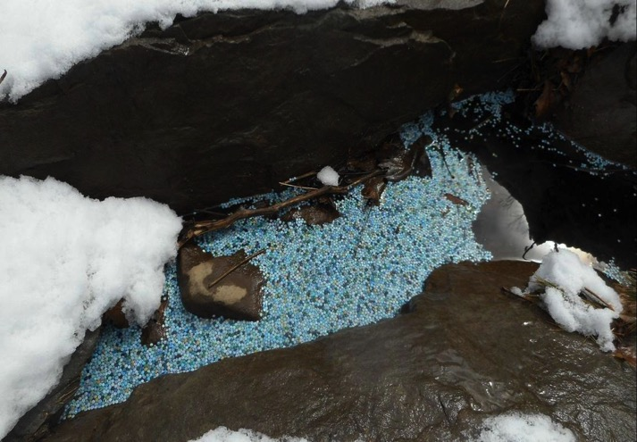
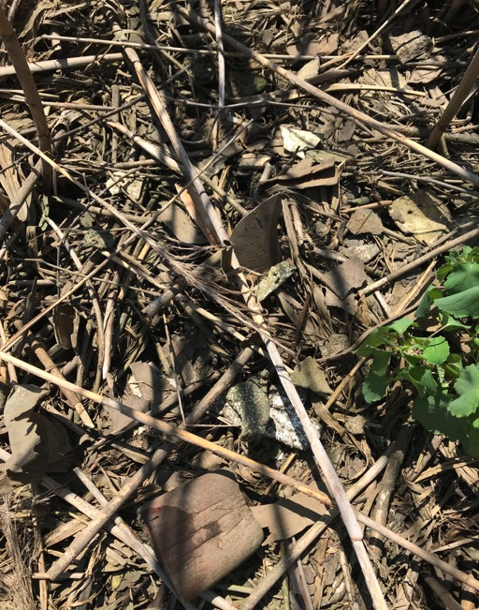
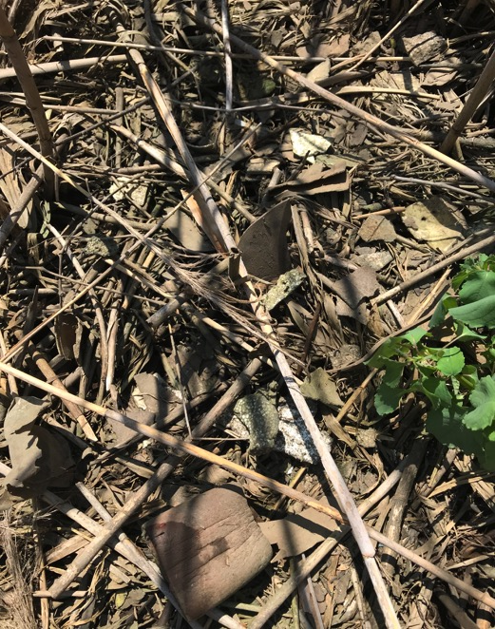
Sixty years later, this is the reality no one anticipated.
Plastic garbage: EPA.gov
Pocono Creek, PA, March 2018
Marsh at JHNWR-Armstrong
Notes:
The amount of plastic we use and discard over the past 60 years has had serious ramifications, as you can see in this image. This picture is not attributed anywhere, but is purportedly from the Manilla harbor. This is an extreme example of the solid waste disposal problem with plastics, but we see impacts close to home as well…

Slide 8
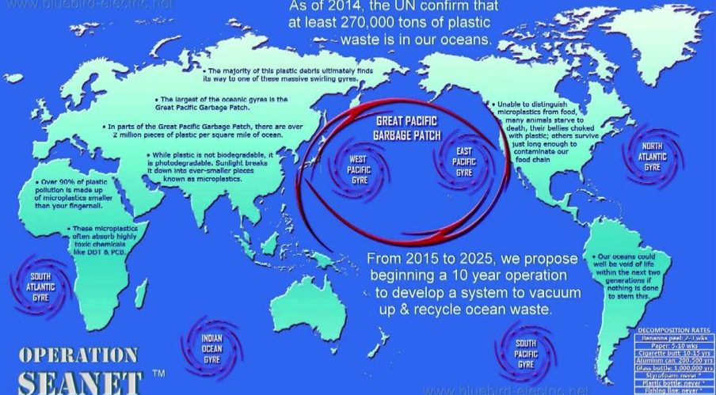
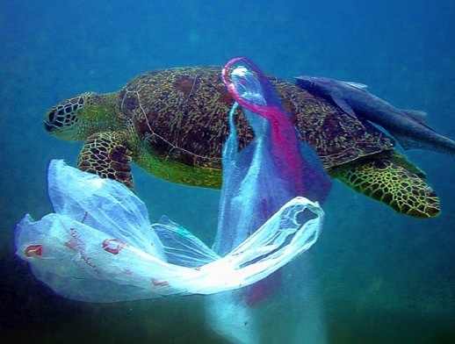
Where do Discarded Plastics Go?
Plastic pollution is the most serious problem affecting the marine environment.
Discarded plastics - 8 million metric tons - make their way into the oceans of the world each year.
Some accumulate when ocean currents bring them together in large currents – gyres. The currents bring plastics from the surface to the ocean floor.
They break down into microplastics (or start that way), and may degrade >500 y.
Macroplastics break down into microplastics by interaction with heat, uv, wind, waves, water, temperature, sand and stone, and bacteria.
Most plastics are below the surface of the oceans and are found throughout the water column.
National Geographic
Notes:
The great plastic ‘patches’ are a soup of plastic, found down to the ocean floor, in all oceans. Concentrations in sediments (by vol.) are 4 to 5 orders of magnitude higher than in the water column (Worm et al., 2017). 8 million metric tons per year of discarded plastics eventually make their way into oceans in natural gathering points where rotating currents, winds, and other ocean features converge to accumulate marine debris, as well as plankton, seaweed, and other sea life. There are several of these patches in the Pacific Ocean. The plastics then begin to break apart into smaller pieces.
Some of you may have heard of the Great Pacific Garbage patch, purportedly twice the size of Texas. According to NOAA, There is no "garbage patch," which in their words, “conjures images of a floating landfill in the middle of the ocean, with miles of bobbing plastic bottles and rogue yogurt cups”. NOAA Marine Debris Program's Carey Morishige explains this misnomer:
“While it's true that these areas have a higher concentration of plastic than other parts of the ocean, much of the debris found in these areas are small bits of plastic (microplastics) that are suspended throughout the water column. A comparison I like to use is that the debris is more like flecks of pepper floating throughout a bowl of soup, rather than a skim of fat that accumulates (or sits) on the surface.”
The Eastern Pacific Garbage Patch (aka "Great Pacific Garbage Patch")
In most cases when people talk about the "Great Pacific Garbage Patch," they are referring to the Eastern Pacific garbage patch. This is located in a constantly moving and changing swirl of water roughly midway between Hawaii and California, in an atmospheric area known as the North Pacific Subtropical High. NOAA National Weather Service meteorologist Ted Buehner describes the North Pacific High as involving "a broad area of sinking air resulting in higher atmospheric pressure, drier warmer temperatures and generally fair weather (as a result of the sinking air)." This high pressure area remains in a semi-permanent state, affecting the movement of the ocean below. "Winds with high pressure tend to be light(er) and blow clockwise in the northern hemisphere out over the open ocean," according to Buehner. As a result, plastic and other debris floating at sea tend to get swept into the calm inner area of the North Pacific High, where the debris becomes trapped by oceanic and atmospheric forces and builds up at higher concentrations than surrounding waters. Over time, this has earned the area the nickname "garbage patch"—although the exact content, size, and location of the associated marine debris accumulations are still difficult to pin down.
https://vimeo.com/24984216
https://prhscience.wordpress.com/page/3/
https://response.restoration.noaa.gov/about/media/how-big-great-pacific-garbage-patch-science-vs-myth.html

Slide 9
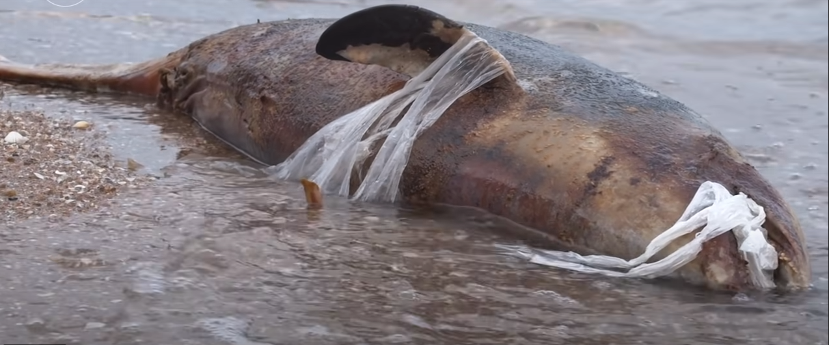
T. Roberts video, “The Great Realisation”

Slide 10
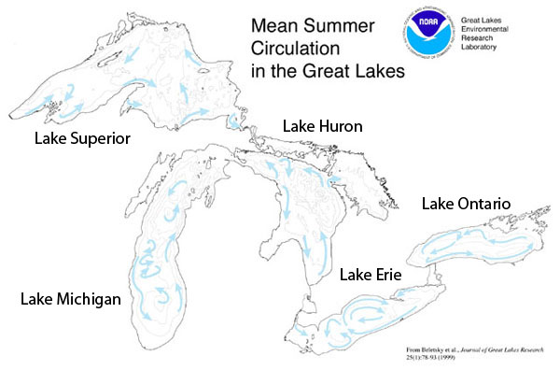
The Great Lakes:
20% of the world’s available freshwater
Microplastic particles in surface water:
Lake Superior & Huron=7,000 per km²
Lake Erie=47,000 per km²
Lake Ontario=230,000 per km²
Lake Huron=~4000 per km²
As high as 466,000/km² downstream
from two major cities
(Eriksen et al., 2013)
*most common:
*Fibers
Films
Foams
Line
*Pellets&microbeads
https://response.restoration.noaa.gov/about/media/there-garbage-patch-great-lakes.html
Notes:
There are similar garbage “patches” in the Great Lakes, which contain nearly 20% of the world's surface freshwater and have a coastline longer than the East Coast of the United States.
In an effort to better identify and understand how plastic debris is spread throughout the Great Lakes, researchers at the University of Waterloo in Canada have partnered with COM DEV on an exploratory research project. COM DEV is a designer and manufacturer of space and remote sensing technology. Researchers are working with this industry partner to develop and test the ability of different remote sensors to detect plastics in the Great Lakes. If they find the task is feasible and the trial runs prove to be effective, this work could be applied beyond the Great Lakes and across the United States. The NOAA Marine Debris Program, part of the Office of Response and Restoration, is engaged with and following the project. They plan to participate in the next steps of this promising effort.
https://response.restoration.noaa.gov/about/media/there-garbage-patch-great-lakes.html

Slide 11
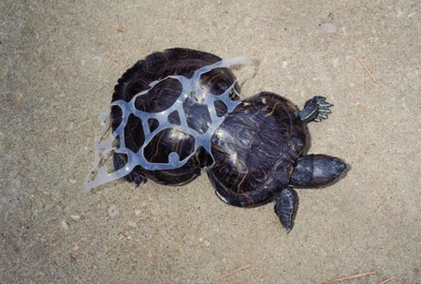
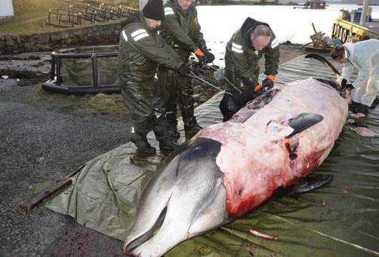
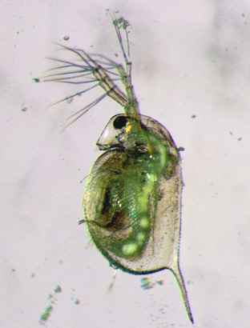
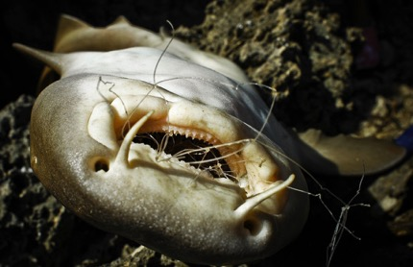
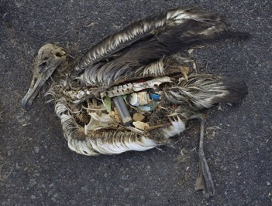
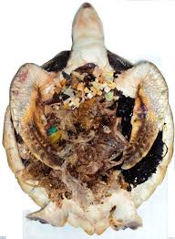
Beached whale in Norwegian waters - 30 plastic bags and large amount of microplastics led to whale’s death.
sea flea
turtle
shark
albatross
Found in most marine species-at least 800.
In beached whales and other sea animals and birds, there is predictably a great deal of plastic, which will not be digested.
Plankton eat plastics. Plastics found in animals living in the deepest ocean trenches.
When an animals eats fish or plankton that has eaten plastic, the toxic chemicals are absorbed. Microplastics lodge in their gills, gastrointestinal tissue.
Of 485 fish tested, 40% had ingested plastic (Penn State). Plastics affect the organs and behavior of fish. Wildlife suffer entanglement, suffocation, and starvation.

Slide 12
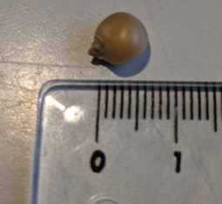
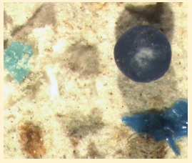
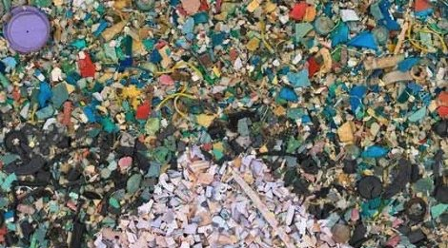
Microplastics are defined as < 5 millimeters in diameter. Nanoplastics are < ~250 nm
Plastics adsorb persistent pollutants. They leach phthalates, polyethylene (PET), polypropylene (PP), polystyrene, PVC, flame retardants, BPA, UV sun screens, etc. into water.
They provide hard substrate for microbes, and gene sequence analysis identified a diverse microbial community referred to as the plastisphere.
MICROPLASTICS
Found in Detroit River
National Geographic
National Geographic
McCormick et al. Microplastic is an abundant and distinct microbial habitat in our fresh water. 2014 Env Sci&Tech
Notes:
So, what are microplastics? How are they different from the plastic trash we are used to thinking about?
According to NOAA, plastics that are less than 5 millimeters in length (about the size of a popcorn kernel) are called microplastics.
https://famvin.org/en/2015/02/13/plastic-waste-becomes-currency-developing-countries/
http://thedailytelecraft.blogspot.com/2011/04/eco-art-recycled-art.html

Slide 13
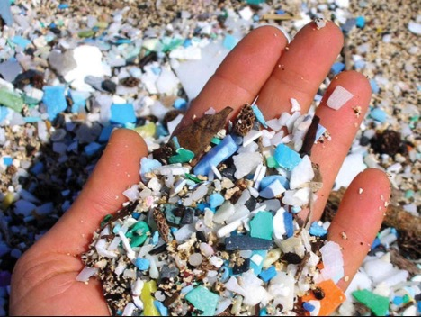
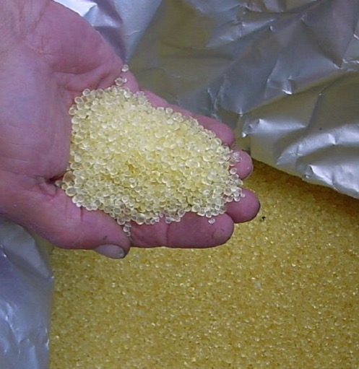
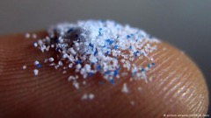


Types of Microplastics (<5mm)
Fragments of larger plastics that have broken down in the environment: micro-pellets, nurdles-virgin plastic for manufacturing.
  Microbeads – tiny pieces of polyethylene plastic that were added to personal care products. Still added to clothing detergent. Look for acrylates, polyethylene, other plastic names.
  Microfibers – small fibers enter the water from washing clothing made of synthetic materials, e.g., polyester, acrylic, and nylon (60% of global clothes). Also in clothing detergent.
  Pellets/nurdles – manufacturing fodder, in toys?
  Line – fishing line and other plastic lines.
  Films – sheets of thin membranes to separate something, hold items, be a barrier, and printable surfaces.
  Foams – structural foams (polyurethane, polycarbonate, polyphenylene oxide, etc), and for bonding to surfaces.
National Geographic
National Geographic
Notes:
Riverwatch Citizen Science, from Buffalo Niagara Waterkeeper, are conducting water quality monitoring of their streams, including plastics sampling. Though lab analysis has not been completed during the reported pilot phase and thus no results yet.
There are two main types of microplastics commonly found in the environment. First are microplastics which have broken down from larger items over time and are now of the defining size, less than 5 mm. The second type of microplastic is known as the micro bead. Microbeads (considered “primary microplastics,” because they start life that way) are small pieces of polyethylene which are added to cosmetics and house hold cleaning products. Together, these are the main sources of microplastics in the environment.
There is some disagreement/divergence about classifying microfibers as a microplastic, but they are a concern, all the same. Plastic microfibers enter the water ways through washing clothes that are plastic-based, such as fleeces.
https://en.wikipedia.org/wiki/Talk:Microplastics

Slide 14
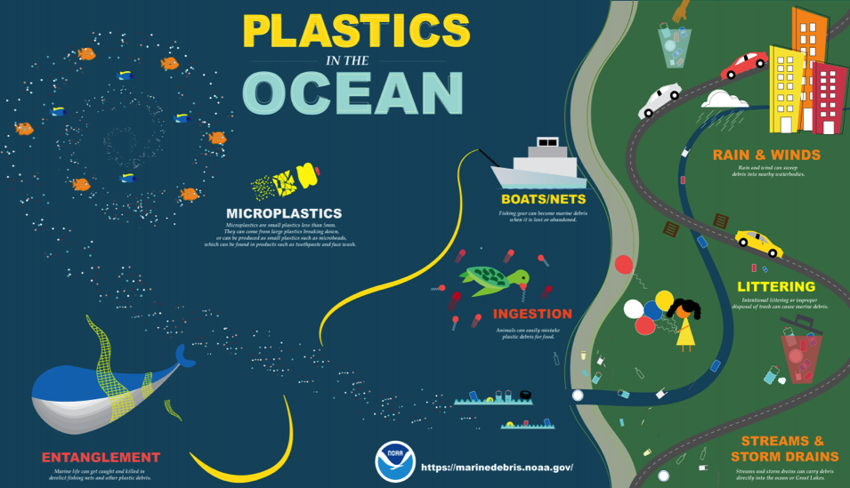
Environmental entry points
Wastewater treatment facilities, trash bins, drains. WWTP cannot filter all microplastics.
On-farm applications of sewage sludge
Atmospheric deposition - greater than previously thought
Break-up of larger plastics
80% of marine plastics originate from land.
Notes:
Some common entry points of micro plastics into the environment, particularly for those of us living inland, are house hold drains, plastic debris from waste bins and waste water treatment plants. WWTPs do not have the capabilities to filter out the micro plastic particles brought in from surrounding areas due to the very small nature of the plastic particles. Because of their treatment limitations, microplastics enter our streams and rivers through the treatment center outfalls and can be found on on-farm applications of sewage sludge (which will also find it’s way eventually to our streams through runoff).
Microfibers have been found floating in the air, and are subsequently deposited. A study in Paris estimated that between 3 and 10 tons of fibers are deposited by atmospheric fallout at the scale of the Parisian agglomeration every year (2500 km(2))
And of course, plastic litter finds its way in our streams and rivers.
Approximately 8 million metric tons of plastics enter the ocean annually and conservative estimates are that 5.25 trillion plastic particles currently circulate in ocean surface waters. 80% of this is estimated to originate from land sources. Next we’ll take an overall look at what happens to plastics once they are in the environment.
https://mr-taylor-sch3u-irp.wikispaces.com/Water+Pollution+%26+Safe+Drinking+Water
https://www.ncbi.nlm.nih.gov/pubmed/26787549

Slide 15
1. Plastics (synthetic polymers) are long chains of monomers with bonds that take hundreds of years to break down. Most are mixtures.
2. Manufacturing plastics creates hazardous waste.
3. >90% produced from fossil fuels by petrochemical companies.
18% of virgin plastic made in NA, 50% Asia, 30% Eur (D’Ambrieres, 2019).
4. Plastic is one of the world’s most-used materials; most overt problems are use of fossil fuels, end-of-life disposal, and loss of economic value.
5. Plasticizers, uv absorbers, flame retardants, etc. can diffuse through the polymer and release into any liquid or air that contact the plastic.
6. Chemicals in plastics are endocrine disrupters - mimic the action of hormones and other signaling molecules by fitting into/binding with receptor sites in many tissues (also pesticides, pharmaceuticals, PCBs, fungicides, plasticizers (BPA), phthalates (more flex/harder to break) etc.
7. Concern is greatest for fetuses and non-adults: affect early sexual differentiation and neurological development.
Basic Facts about Plastics
Notes:
Micro plastics are not a new problem however not a lot of attention had been paid to them in the past. We are just now beginning to tackle the root cause of these problems. The micro bead free waters act of 2015, which we’ll talk about later, is one of the first steps in taking action to address the issue.
Although microplastics have been around for a long time, it is only recently that scientists and the public have become aware of just how serious the problem is.
The microplastics from breakdown of larger items find their way into our local streams and rivers, soils and ultimately oceans, coming from plastics discarded long ago. Most plastic pollution originates on land, and flows downstream.
Plastic microbeads appeared in personal care products about 50 years ago, with plastics increasingly replacing natural ingredients.
As recently as 2012, awareness of microplastics was still relatively low.

Slide 16
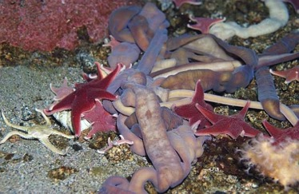
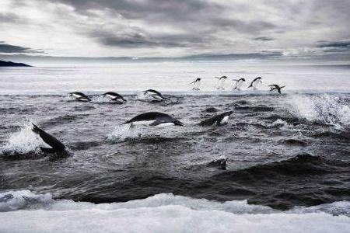

What is at risk?
Plastics released to the environment serve as
carriers of organic contaminants to life. This pollution and plastic additives are transported to animals.
A. Molecular sizes of synthetic polymers are too large to pass through the cell membrane. But, toxic chemicals attached to plastics are of smaller sizes that can penetrate into cells, cross BBB or placenta.
B. Plastic additives (e.g., flame retardant, antimicrobial) leach from plastic and transfer to the tissues of animals. More dense plastics accumulate in sediment where they are eaten by aquatic species (e.g., lugworms, eaten by fish).
The extra 33B tons of plastic on the planet by 2050 raises concerns about habitats where plastics in sediments exceed 5% by mass (Browne et al., 2013).
Both pollutants and additives damage the immune system which is more subject to:
  1. Oxidative stress; 2. Reduced Feeding; 3. Immune dysfunction; 4. Mortality.
Notes:
Browne MA, Niven ST, Galloway TS, Rowland SJ, Thompson RC. Microplastic moves pollutants and additives to worms, reducing functions linked to health and biodiversity. CURRENT BIOLOGY 2013, 23, 2388-2392.

Slide 17
Can plastics cause diseases?
Bisphenol A (BPA) – used in polycarbonate plastics often in containers to store food and beverages such as water bottles; and in epoxy resins that coat the inside of metal products such as food cans, bottle tops, water supply lines, some dental sealants and composites – kidney disease, diabetes II, autism, ADHD, Alzheimer’s Dis, Parkinson’s Dis. (Zeliger 2013)
Phthalates – added to plastics to increase flexibility, transparency, durability, longevity, especially to soften polyvinyl chloride – diabetes II, cardiovascular dis, hypertension, sexual organs, thyroid, etc (CDC)
  Persistent Organic Pollutants (POPs) remain in adipose tissue up to 30+ ys – cancer, immune system suppression, cognitive and neurobehavioral fn, sex steroid and thyroid fn, hypertension, cardiovasc, diabetes (Carpenter 2011)
  Polynuclear aromatic hydrocarbons (PAHs) – were in higher levels than virgin plastic debris suggesting produced during manufacturing (Van A 2011)
Lipophilic chemicals: Rates of diagnosis changed from 1990-2010 (Zeliger 2013):
  Cognitive, neuropsychiatric, and behavioral disorders increased by >37%
  Parkinson’s disease increased by 75%
  Alzheimer’s disease increased by 100%
  Autism increased by 30%
  ADHD increased by 16%
  Diabetes increased about 200%
  Cardiovascular disease

Slide 18
Can these diseases be averted?
World Health Org states that 24% of environmentally associated disease (known by publication in 2006) is caused by environmental exposures that can be averted.

Slide 19
How are we exposed to plastics?

Slide 20

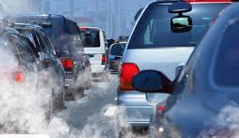
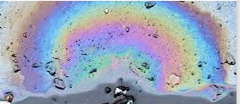
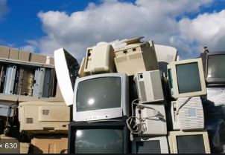
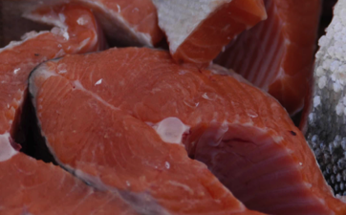
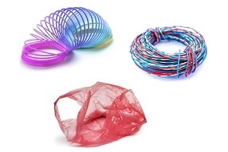
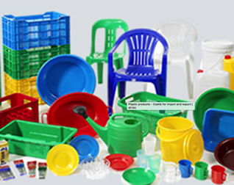
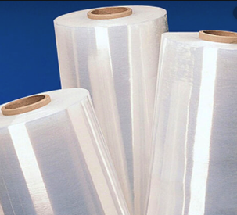
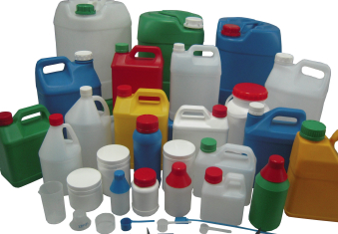
Plastics adsorb contaminants
A
  CONTAMINANTS
Plastic debris in the water attach with chemicals, like:
  PCBs – polychlorinated biphenyls
  PAH – polycyclic aromatic hydrocarbons
  Petroleum hydrocarbons
  Organochlorine pesticides and solvents
  Polybrominated diphenylethers
  Alkylphenols and bisphenol A (BPA)
  SEE EPA’s Tox Town site for more info.
C
B
E
F
  PLASTICS
Polyethylene accumulates more organic contaminants than other plastics. It is the most popular plastic in the world.
Notes:
Teuten EL, Saquing JV, Knappe DRU, et al. Transport and release of chemicals from plastics to the environment and to wildlife. Philosophical Transactions of The Royal Society. 2009, 364, 2027-2045.
This paper includes authors from England, Scotland, USA, Sweden, Japan, Vietnam, Cambodia, The Phillipines, Thaliland, Malaysia, LAO People’s Democratic Republic.

Slide 21
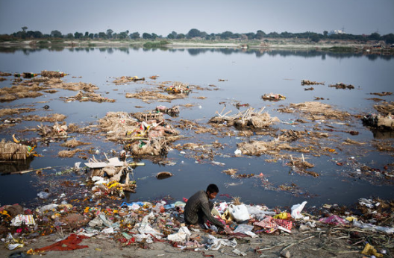
Plastics interact with other pollutants such as:
Silt carrying nutrients
Fats and grease from food waste
Detergents
Agricultural runoff
Herbicides
Pesticides
Pharmaceutical waste
Eutrophication
Ocean acidification
Microplastics are stressors for biota and affect growth, reproduction, and species interactions.
1. Continuing release of microplastics through breakdown of littered plastics already present in the environment, and 2. high demand of plastic materials/products will increase, means microplastics may be an increasingly important freshwater pollutant in the future.
A NEW ELEMENT AND EMERGING CONTAMINANT IN THE STREAM ECOLOGICAL HABITAT.
Zettler et al., 2013, Env Sci&Techn; Scherer et al., 2017, Handbook of Environmental Chemistry
Notes:
These are some of the pollutant interaction concerns with plastics that are being explored through research.

Slide 22
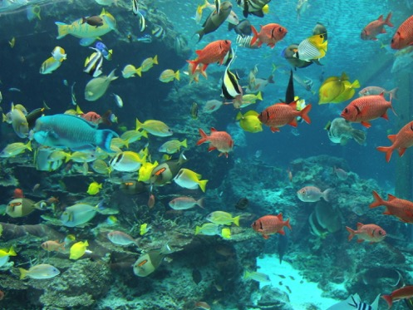
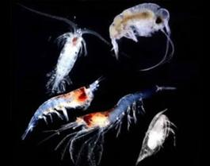
Microplastics in the food chain
Studies are being done to quantify the amount of microplastics present in the food chain.
Microplastics are suspected to be present in all parts of the food chain from filter feeders to apex predators. From pole to pole. From mountaintops to bottom of oceans.
Bioaccumulation leads to higher levels of contamination.
Biodegradation does not occur because so few organisms use it as a food source.
National Geographic
National Geographic
Notes:
There is growing concern that micro plastics are present in the food chain. These Zooplankton can mistake the plastic for food and ingest the tiny particles. Fish then feed on this plankton which could introduce the particles to the fish. As we move up the food chain the particles concentrate through a process known as bioaccumulation. This has the potential for increasing public exposure to harmful chemicals through seafood consumption.
https://kids-book-club.wikispaces.com/Down%2C+Down%2C+Down
https://commons.wikimedia.org/wiki/File:Fish_in_Okinawa_Churaumi_Aquarium.JPG

Slide 23
Are microplastics found in our food?
Microplastics in the marine environment are transferred to sea salt through sea water. (Yang, D., et al. , 2015. Microplastic pollution in table salts from China. Environ. Sci. Technol; Kosuth et al, 2018. Anthropogenic contamination of tap water, beer, and sea salt. PLOS One)
Seafood such as swordfish, albacore, bluefin tuna, oysters, shrimp, and mussels ingested and bioaccumulated not only plastics but the toxic chemicals that had been sorbed on microplastics (Rochman, et al., 2013. Ingested plastic transfers hazardous chemicals to fish and induces hepatic stress. Sci. Rep.)
Microplastics were found in 81% of tap water samples in the U.S. >98% were fibers.(Kosuth, wt al.. 2018. PLOS One). Mason et al. found 5.45 particles of plastic/liter, twice the rate found in bottled water (93% of samples from around the globe contained plastics).
Microplastics found in all of 12 brands of Great Lakes beer (Kosuth, et al., 2018. PLOS One)
The average person may ingest over 5,800 particles of synthetic debris from sea salt, tap water, and beer each year, with most coming from tap water. Less in ground water, but found in Karst formation (Hoellein et al.).
There are no federal standards for the amount of plastic that seafood can have when sold for food.
The World Health Org reported (2019) that based on limited data, there was no significant human health risk from drinking plastics and its biofilms (plastisphere). "No data suggests overt health concerns associated with exposure to microplastic particles through drinking-water." Rationale – low levels, not that the chemicals are not harmful to humans. Report did not mention endocrine disruptors and developmental effects.
Notes:
The studies continue… read above slide.
Adborbed pollutants include Polychlorinated biphenyls (carcinogenic), polycyclic aromatic hydrocarbons (carcinogenic, developmental), organochlorine pesticides (carcinogenic, neurotxic, endocrine, reprodutive/develpmental), cadmium (carcinogenic, renal toxic), chromium (carcinogenic), lead (neurotoxic)

Slide 24
Microplastics in animal tissues
Potentially the body is absorbing, distributing, metabolizing, and excreting microplastics (NJ DEP)
Austrian Environmental Agency found 9/10 types of plastics in 8/8 humans' stool samples from 8 countries, most commonly polyethylene and polypropylene (bags, bottles, plastic food wrappers, synthetic clothes).
Polystyrene beads transferred from insect larvae to the gastrointest sys of adult mosquitos (Al-Jaibachi et al 2018)
Microplastic endpoints in fish and mammals: endocrine, liver, muscle, immune response, gills, circulatory, intestine, olfactory, gonads, respiratory, genes/DNA. (Smith et al., 2018, review, Curr Env Health Rep.)
Plastics found in chicken gizzards (digestive tract).
Plastic beads transferred from rodent placenta to fetus.
Autopsies of people w knee or hip replacement showed PE particles in abd. lymph nodes (68%), liver/spleen (14%).
Terrestrial ecosystems absorb plastic – 1/3 of all plastic waste end up in soils or freshwaters (Anderson et al. 2018)
Plastics transferred to soils – Estimate of 110k-730k tonnes of microplastic to agricultural soils/yr in US and Europe (Nizzetto L, 2016). Microplastics interact with soil fauna – earthworms.
Notes:
Microplastics have also recently been found in human waste. An Austrian study tested 8 humans’ stool samples for 10 different types of plastic and found 9 of them in all the subjects, most commonly PET and polypropylene, which are common in plastic food wrappers and synthetic clothing. What we don’t know yet, are the exact sources of the plastic.
https://tpw.nationalgeographic.com/environment/2018/10/news-plastics-microplastics-human-feces/

Slide 25
What is found in the home?
Parisian roof top collection of microplastics in 2014. Surface of sampling was 0.325 m2 and occurred from 7 to 30 days. More than 90% were fibres. Amounts ranged from 29-280 particles per m² per day (x=118), and highest amounts found during rainfall though no clear correlation w weather. (Dris et al, 2018).
~30% of indoor dust is plastic microfibers (Dris et al., 2017)
Sources of airborne microplastics are synthetic textiles from clothing and household items, and land-based application of plastics retained in sewage sludge.
Estimated human exposure from indoor atmospheric fallout - ~68,000 microplastic fibers/year (Catarino et al., 2018).
Notes:
When discussing the problem, remember that the impact of micro plastics on the environment is not yet fully understood. Standardized micro plastic testing protocols are just now being developed to quantify the problem globally. NOAA, the National Oceanic and Atmospheric Administration is helping to develop these protocols. This is an important fact, as fully developed information can be difficult to obtain, while, at the same time, common sense tells us that plastic trash and debris in the oceans is not a good thing. From a human standpoint, though, our exposure to plastics in wrappers and containers may be a far larger threat than the ingestion of microplastics.

Slide 26
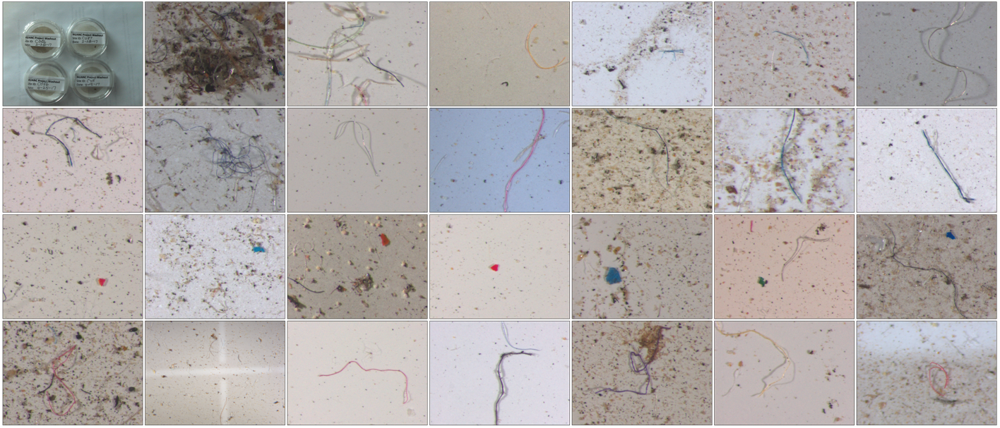
What is found outside?
Nov. to March data collection of microplastics deposition in remote Fr. Pyrenees, and found x=249 fragments per m² per day. (Allen et al., 2019)
USGS study of CO Rocky Mountains: microscopic plastics were ubiquitous – unexpectedly found in >90% of samples, mainly fibers, greater # in urban than remote sites. (Wetherbee et al., 2019)
Notes:
When discussing the problem, remember that the impact of micro plastics on the environment is not yet fully understood. Standardized micro plastic testing protocols are just now being developed to quantify the problem globally. NOAA, the National Oceanic and Atmospheric Administration is helping to develop these protocols. This is an important fact, as fully developed information can be difficult to obtain, while, at the same time, common sense tells us that plastic trash and debris in the oceans is not a good thing. From a human standpoint, though, our exposure to plastics in wrappers and containers may be a far larger threat than the ingestion of microplastics.

Slide 27
What can we do?

Slide 28
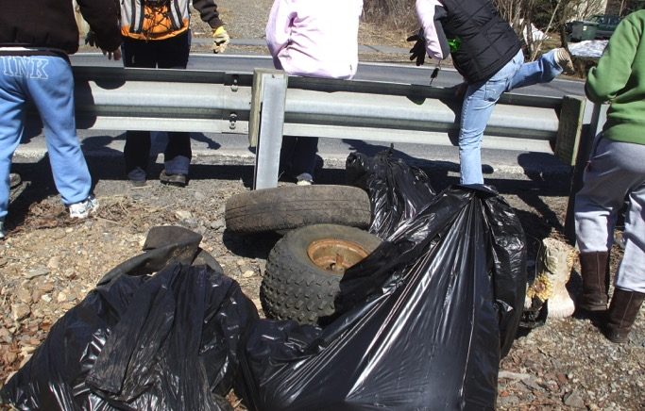
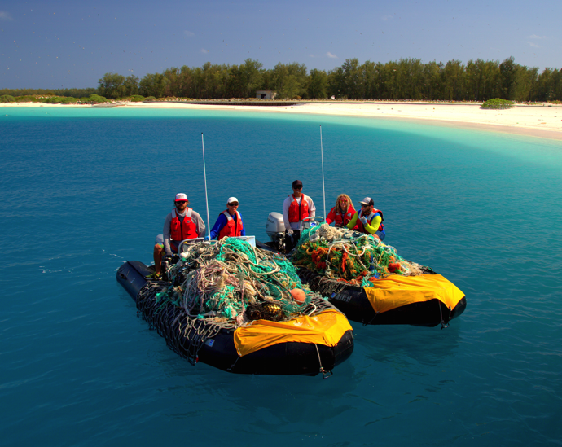
Types of Solutions
Regulatory
Business Action
Individual Action
Community Action
Science&Technology
Octoraro Reservoir Clean up
Northern Hawaii islands derelict gear clean up
Notes:
There are 4 categories of solutions that we’ll highlight: Regulatory, individual action, community action and emerging technologies that help to address the issue.

Slide 29
Policy Development
Understand the presence of plastics and its impacts.
First - Prevent further inputs into freshwater, air, and land. Second - Reduce the total amounts in the environment. Solid waste stream must be minimized in streams, estuaries, coasts.
Develop educational programs.
Develop standardized monitoring techniques – See NOAA, Laboratory Methods for the Analysis of Microplastics in the Marine Environment.
Develop research priorities.
Develop regulatory actions - legislation to address microplastic spills.
Urge your federal representatives to fund NSF, EPA, and other federal science agencies to engage in systematic studies of chronic low levels of plastic ingestion. Funding not available to scientists currently except from NOAA.
Eerkes-Medrano , et al. 2015. Microplastics in freshwater systems: A review of the emerging threats, identification of knowledge gaps and prioritization of research needs. Water Research.
Thevenon, et al. 2014. Plastic debris in the ocean: The characterization of marine plastics and their env’l impact, situation analysis report. Intl Union for Conservation of Nature and Natural Resources.
Notes:
Other work is being done to see if bacteria can degrade plastics. Because bacteria and fungi did not evolve in conjunction with plastics, it was long thought that no living organisms would attack plastics…but perhaps this is not an absolute?
https://phys.org/news/2016-03-plastic-munching-bacteria-fuel-recycling-revolution.html

Slide 30
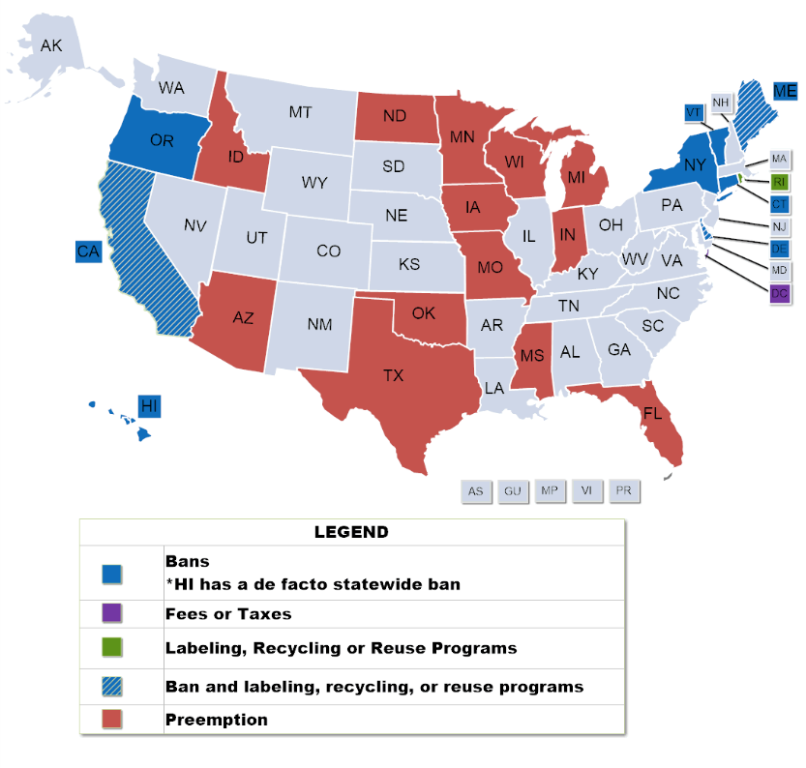
Plastic Bag Bans, Fees, and Recycling
Regulatory
  States introduced at least 95 bills related to plastic bags in retail settings. The majority of bills propose a ban or fee on bags. Others enacted legislation that preempt local government action or improve bag recycling.
  Nat’l Conference of State Legislature - 2019
  2020: Ten States banned single-use bags
  California Maine New Jersey
  Connecticut New York
  Delaware Oregon
  Hawaii Vermont
  ND, TX, OK, PA preempted local govt.
  Canada proposes ban single use plastics by 2021. China announced banning some plastics
  Major cities with plastic bag bans &/or fees:
  Boston, Chicago, Cleveland, Los Angeles, San Francisco, Seattle, Boulder, Montgomery County MD, NYC, Philadelphia, Portland ME, Portland OR, Washington DC.
Notes:
To date, there have been 73 bills introduced in state legislatures regarding the use of plastic bags. California was first state to enact a bag ban, then followed Hawaii.
Cities with bag bans: Austin, Tx, Boston, MA, Chicago, IL, Los Angeles, CA, San Franciso, Ca , Seattle, WA
Cities with bag fee: Boulder, Co, Brownsville, TX, Montgomery Cty, MD, New York, NY, Portland, ME, DCC.
In 1991, In 1991, Maine became the first state to enact legislation requiring recycling efforts at retail stores. The law prevents retailers from supplying plastic bags unless they provide a convenient storefront receptacle to ensure used bags are collected and recycled. Since then at least four other states—California, Delaware, New York and Rhode Island— and the District of Columbia have followed suit.
http://www.ncsl.org/research/environment-and-natural-resources/plastic-bag-legislation.aspx

Slide 31
The status of bans on polystyrene - Styrofoam_{TM}
Regulatory
PA’s ban on polystyrene – status. In 2018 the senate bill died in the Senate Environmental Resources and Energy Committee.
In 2019, Maryland passed a bill to become the first state in the country to ban polystyrene foam food containers and cups (passed in the House 100-37). It was allowed to become law by Gov. Hogan by not vetoing it.
In 2019 Maine banned polystyrene foam food containers in restaurants and grocery stores that Gov. Mills signed.
PA’s bill to prevent banning plastics expires when assessment report is to be completed July 1 2020.

Slide 32
Regulatory Actions to Consider
Regulatory
Restrict alternative methods for managing end-of-life plastics
  Taxes on landfills (France and UK), or outright bans on landfill disposal. European Union set target of limit of 10% plastic waste to landfill by 2030 (now 30%).
  Separated collection systems or innovative collection arrangements involving consumers and brands (EU: 90% collection target for plastic bottles by 2025)
  Cost factors have determined manufacturers purchase of recycled plastic, thus dependent on price of crude oil that can cause volatility in recycling sector. Thus, decouple the market for recycled plastic from the market for raw plastic by requiring recycled plastic in products (EU: beverage containers must contain at least 35% recycled plastic by 2025.
  Innovations in sorting technologies open the possibility of processing new flows and more yield, such as AI. Marginal decrease in production costs can drive the recycling sector.
  Change consumer demands and behaviors - occurring in food industry
  Consumers must be convinced to sort their waste properly, an issue for public authorities to provide guidelines and their standardization.
Notes:
Woldemar d’Ambrieres. Plastics recycling worldwide: Current overview and desirable changes. Field Actions Science Reports, 2019, Special Issue: Reinventing Plastics., pp12-21.

Slide 33
1. Recycled plastics meet about 10% of global demand for plastic.
2. Cannot always substitute recycled plastics for virgin because must be traceable for food packaging, some uses must withstand very high pressures.
3. Recycling plastic avoids about 25% of emissions of CO² compared to that generated during production of raw plastic (D’Ambriere, 2019).
4. More jobs associated with a recycling plant than a landfill, incineration, or petrochemical industry synthesis of virgin resins (D’Ambriere, 2019). It supports local industry, and supports independence of economy in countries with few oil or gas resources.
5. Products can only be recycled economically if
(1) recycling is built into their design,
(2) there are sufficient quantities in waste streams,
(3) manufacturer can meet the technical challenges involved in increasing the amount of recycled materials in their products,
(4) no problematic odor or color.
Business
Basic Economic Facts about Recycling
Notes:
Berkeley’s Lawrence

Slide 34
1. Many products are composed of different types of plastic and sometimes non-plastic components – contaminated. TerraCycle works with brands, retailers, and manufacturers to create new product designs and packaging that can be recycled because not contaminated. TerraCycle launched Loop: Pilot program consumers can purchase at select Kroger’s stores and return the food and product containers durable, reusable, or fully recyclable back to the vendor.
2. Plastic production and application is continually expanding, but the lifetime of plastic products is typically short. New plastic introduced by DOE LBNL
.
3. There are many different types of plastics, with widely different properties, that can make recycling problematic.
4. Plastics can only be reused a limited number of times before they are too degraded for further use. E.G., reprocessing of PET polymer leads to discoloration and change in polymer properties of elasticity, strength, barrier.
5. New applications must be selected according to new color and properties.
Properties of a polymer can change over time resulting in inferior mechanical properties and/or processing behavior compared to virgin material.
Business
Circularization of Plastics – Recycling
Not really a circular economy – feedstock for durable plastics.
Notes:
Medical industry to change packaging to pure plastics that can be recycled.
Asian countries will soon either refuse plastics or will only accept a single type plastic, except India.
Before the supplier of plastics would be paid for recycling; now companies must pay to have their materials recycled.

Slide 35
Business
Incineration of Plastics
Incineration of plastics is monetized (EU burns almost 42% of its waste, US burns 12.5%: National Geographic), but emit toxic pollutants (e.g., dioxins, acid gases, heavy metals) and operation of scrubbers is not enforced. (www.epa.gov/air-emissions-monitoring-knowledge-base/monitoring-control-technique-wet-scrubber-gaseous-control)
Gasification melts plastics at very high temperatures in near absence of O² so toxins are not formed, and generates synthetic gas that is not competitive with natural gas. Many more plants in Asia and Australia.
Pyrolysis melts plastics at lower temperatures than gasification and with less O², and can be refined to diesel fuel and other petrochemical products including new plastics. Seven small pyrolysis plants now operating in US. Reportedly produces no harmful pollutants except “a minimal amount of carbon dioxide” (Bakaya, founder of Renewology), but not all companies have met the pollution control limits.

Slide 36
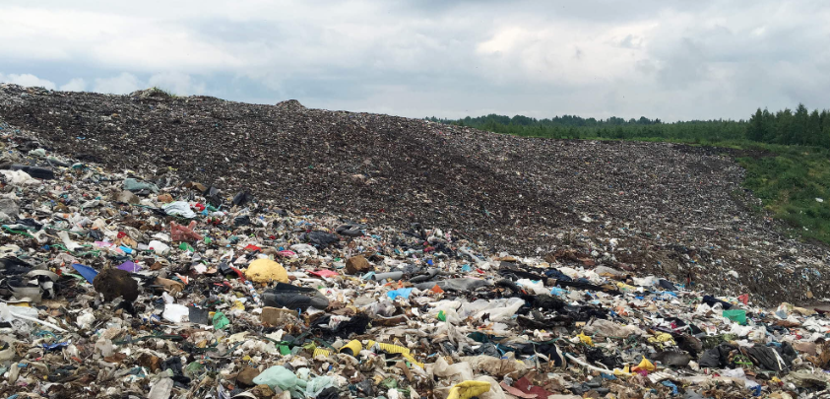
Engineered areas of land for the controlled deposit of solid waste.
MSW landfills comply with Resource Conservation and Recovery Act (RCRA), including siting restrictions in floodplains, surface/groundwater protection, disease and vector control, open-burning prohibitions, explosive gas (methane) control, fire prevention through the use of cover materials, and prevention of bird hazards to aircraft.
After adoption of the first RCRA in 1968, the total # of landfills in the U.S. steadily declined. Despite the diminishing percentage of total MSW disposed of in landfills, the total waste capacity of landfills is still increasing.
Landfill gas can be utilized by a gas turbine producing electricity or pipeline-grade gas from methane piped from a large landfill.
Landfills
Landfills

Slide 37
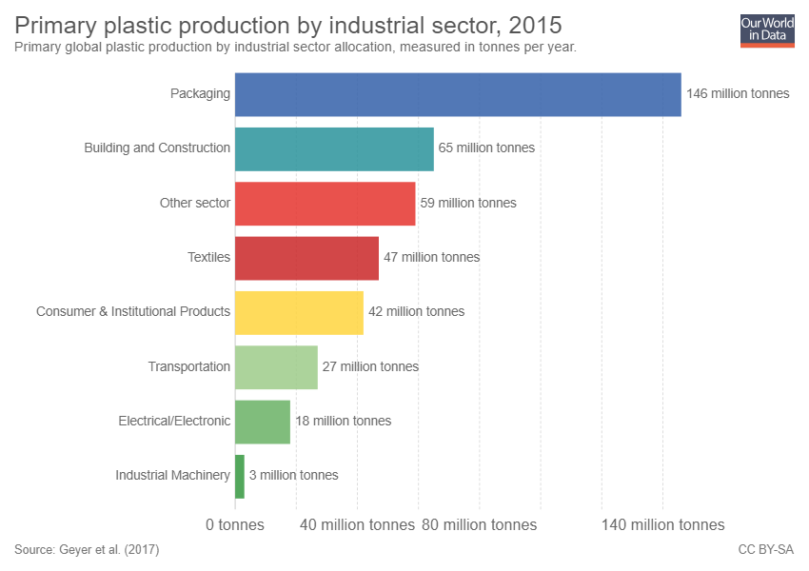
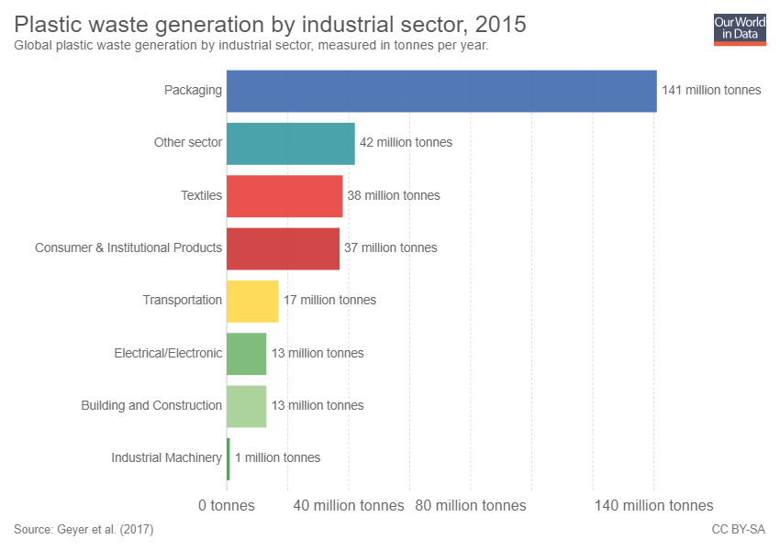
Global production and waste (2015)
96% waste
20% waste
71% waste
81% waste
88% waste
63% waste
72% waste
33% waste
Notes:
Geyer
From California EPA – Air Resources Board:
The consumer products regulation applies not only to “household products” used by individual consumers around their homes, but it also applies to products that are commonly known as “institutional products” or “industrial and institutional (I&I) products.
Establishments” include, but are not limited to, government agencies, factories, schools, hospitals, sanitariums, prisons, restaurants, hotels, stores, automobile service and parts centers, health clubs, theaters, or transportation companies.
“Institutional Product” does not include household products and products that are incorporated into or used exclusively in the manufacture or construction of the goods or commodities at the site of the establishment.

Slide 38
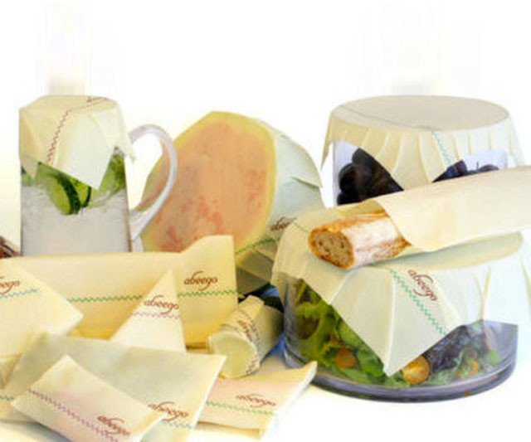
Refuse, Reduce
Individual Actions
Look for products that use less or no packaging.
Store, freeze, and heat food in glass rather than plastic – for your health.
Plastic wrapping is the largest use of plastic. You can do something!
Notes:
Refuse and reduce when possible. Look for products that use less packaging. Packaging contributes huge amounts of plastics that end up in the environment and eventually be broken down into microplastics.
While most plastics can be recycled, studies have shown that a large percentage of them are not recycled and add to the over all amount of micro plastics being introduced into the environment. Reusable containers along with alternative eco friendly materials can help reduce the problem.
http://www.dudeiwantthat.com/gear/food-drink/abeego-beeswax-food-storage-wrap.asp
https://abeego.com/

Slide 39
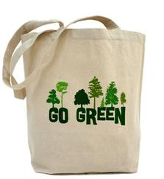
Individual Actions
Refuse, Reduce
Choose reusable wrappers - bees wax wraps and glass containers.
Eat in at restaurants instead of taking out.
Take reusable container to restaurants for leftovers!
Make use of bulk bins at grocery stores and bring your own containers.
Avoid products with microbeads. If polyethylene or polypropylene on label, has microbeads.
Use reusable cloth bag when shopping.
Say no to plastic straws. #stopsucking (Strawless Ocean Initiative of Lonely Whale (501 (c) 3)
Notes:
These are additional ways of reducing your use of plastic products.
Read list.
Paper straws are becoming more common. There are also glass and metal straws available.

Slide 40
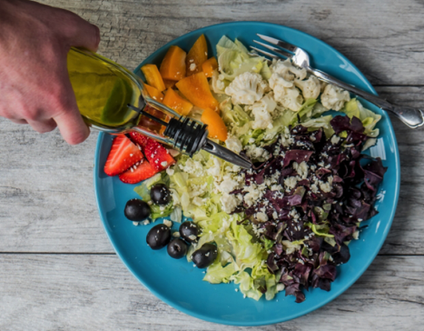
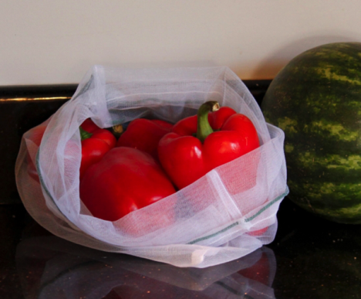
Can You Cook a Plastic-Free Meal? (NOAA MDP)
Did you cereal and milk come in plastic waste cereal bag and milk jug? Was your fruit in a plastic bag or container? Were the coffee grounds in a plastic bag?
So much of our food is covered in plastic, having a meal with only ingredients not found in plastic packaging can be a real challenge, but not impossible. You can also reduce the amount of plastic when shopping.
Challenge yourself to make your own plastic-free meal.
  Go the butcher and ask for meat in butcher paper instead of plastic.
  Bring your own produce bags and not use any plastic.
  Buy in bulk with your own container.
  Make your own food, such as granola and granola bars.
  Challenge yourself to make at least one plastic-free meal/week. Share with others

Slide 41

Reduce, Recycle
Individual Action
Plan ahead - fill water at the tap.
Use reusable drinking water bottles made of stainless steel, not plastic.
Reuse and recycle single-use plastics.
Encourage others. Teach by sharing your story.
Events – set example for no
single use plastics
Use it forever.
Notes:
Try to plan ahead, fill water at the tap rather than purchasing bottled water when out doing activities.
Use reusable drinking water bottles made of stainless steel or other non plastic materials.
If you do use single use plastics make sure they make their way into a recycling bin after use.
Encourage others to do the same by teaching them the information that you have learned.
Other ways to help the reduction of micro plastics is to avoid single use plastic containers. Filling water at home in a stainless steel reusable container can help and has many other benefits as well. If you must use single use plastic containers make sure they find their way into a recycling bin. Teaching others to the same is also a good practice.
https://commtechgr10.wikispaces.com/Commtechgr10

Slide 42

Mind Your Clothes!
Individual Action
Clothing made from plastic such as nylon, polyester, rayon, acrylic and spandex, shed hundreds to thousands of microfibers with each wash.
Fleece and other synthetic fabrics – wash less often. Use microplastic catching bags. (Ex. Patagonia guppy bag friend that catches microplastics in wash)
  Researchers from the University of California Santa Barbara's Bren School of Environmental Science & Management found that when synthetic jackets are washed, on average 1,174 milligrams of microfibers are released from the washing machine. These microfibers then travel to local wastewater treatment plant, where up to 40% of them can enter rivers, lakes, and oceans (depending on local wastewater treatment conditions).
Notes:
Taking a proactive approach as a consumer can also help to reduce the overall problem. Synthetic fabrics such as fleece do release micro plastics into the wash. A study in California showed that when synthetic jackets are washed, an average of 1,174 milligrams of microfibers are released in the washing machine (about ½ a tsp). Washer bags such as the Patagonia guppy friend bags will catch these fibers before they can reach the environment.
http://www.patagonia.com/product/guppyfriend-washing-bag/O2191.html
https://brenmicroplastics.weebly.com/project-findings.html

Slide 43

Reuse
Individual Actions
Buy used.
Buy reusable over disposable items.
Maintain and repair products.
Borrow, rent or share items.
Try to use something longer.
Break the bond of trending fashion and planned obsolescence.
We are never more than three feet away from something plastic.
Susan Freinkel, 2011
Notes:
Reuse what you can.
Buy used. You can find everything from clothes to building materials at specialized reuse centers and consignment shops. Often, used items are less expensive and just as good as new.
Buy reusable over disposable items. Look for items that can be reused; the little things can add up. For example, you can bring your own silverware and cup to work, rather than using disposable items.
Maintain and repair products, like clothing, tires and appliances, so that they won't have to be thrown out and replaced as frequently.
Borrow, rent or share items that are used infrequently, like party decorations, tools or furniture.
Text from EPA.

Slide 44


Recycle
Individual Actions
Close lid on trash and recycle bins.
Don’t litter.
Pick up litter, the smallest are most likely to be eaten by aquatic wildlife due to scarcity of food in the aquatic environments. Aquatic environments are declining at a much faster rate than terrestial ecosystems. (National Geographic)
Look for products made from recycled plastic materials.
Marsh Creek PA
Acadia National Park ME
Notes:
Recycle is at the bottom of the list, since the market for recycled materials is struggling. The Sea Grant shared with us that “in NW PA, only #1 and #2 plastics are recycled. No market for #3 through #7. In addition, our waste hauler has just decided they will no longer accept glass for recycling, so we need to really get creative”.
Almost 35 million tons of plastics were generated in the United States in 2015, about 13 percent of the waste stream. Only 9.1 percent of plastics were recycled in 2015. Some types of plastics are recycled much more than others. Most community recycling programs accept some, but not all, types of plastics. Look for products made from recycled plastic materials to help support the industry.

Slide 45

NOAA Marine Debris Clearinghouse
Community Actions
Gulf of Alaska
If you want to know more about studies being funded by NOAA that are experimental or naturalistic, visit: https://clearinghouse.marinedebris.noaa.gov/
Participate in the annual International Marine Debris Coastal Cleanup, organized by the Ocean Conservancy, every September. Resulting data goes to NOAA and international groups to track plastics where you live and around the world
Participate in your local watershed, wildlife refuge, and other environmental debris clean-up actions.

Slide 46





Community Action
Organize and schedule community clean ups.
Urge your favorite restaurants to use reusable or compostable ware and packaging.
Work with your municipality to offer recycling events and to encourage businesses to reduce single use plastics.
Work with your local watershed groups to conduct citizen science research on local streams – more on this.
Educate others about plastic pollution and solutions. Inspire by example!
Notes:
Once you begin to become aware of the problem you will see plastic waste everywhere. Luckily there are solutions to the problem. READ THE ABOVE INFORMATION.
http://thecooltundra.wikispaces.com/How+can+we+protect+the+tundra%3F?responseToken=8b6d371dae4f1f4c446ce3fc0752b158

Slide 47

Community Action
Educate students and teachers to become trash free.
Goals: Reduce littering behavior by understanding their local watershed, recognizing the impacts of their waste and litter, and empowering them to be student leaders on debris prevention
The Alice Ferguson Foundation in NJ works with 6th-12th grade students:
  Multiple classroom visits
  Student-led action projects
  Peer-to-peer mentorship program with local elementary school students
Notes:
https://chesapeakebay.noaa.gov/funding/funded-awards
B-WET Funding
$294,098 2015-2019 + nonfederal match of $54,749

Slide 48

Urban stream plastic and debris removal
Technologies
Baltimore’s Trash Wheel system: Collects trash before reaching open waters of Baltimore Harbor and Chesapeake Bay
14 foot steel water wheel powered by river current, that uses a rake and conveyor system that pulls floating litter and debris and deposits into a dumpster barge. Has an array of 30 solar panels to power the water pumps so machine operates when current is slow. During a large rainstorm the two systems work in tandem to power the machine to collect anything that floats from a single cig. butt to a tree. Funded by Maryland Port Administration and a subsidiary of Exelon (Constellation). Dept. of Public Works helps pay for ongoing operation with stormwater remediation fee established by state law in 2012.

Slide 49



Emerging Technologies
Concentrates plastic just beneath surface of the ocean gyre, and remove it by support vessel. Uses 600 m long floater and 3 m deep skirt below.
https://www.theoceancleanup.com/

Slide 50

Emerging Science
Plastic marine debris provides an artificial hard substrate for microbes – termed a Plastisphere (Zettler et al. 2013).
Plastisphere communities are a diverse microbial community.
Zettler et al., 2013
Distinct from surrounding surface water, as such they are a novel ecological habitat in the open ocean.
The identification of several hydrocarbon-degrading bacteria suggest microbes might play an important role in degrading plastic marine debris.
Future research needed to understand biodegration of microorganisms and enzymes in seawater and sediment, with hopes to develop innovative bioremediation processes for waters contaminated by plastics.
Notes:
Other work is being done to see if bacteria can degrade plastics. Because bacteria and fungi did not evolve in conjunction with plastics, it was long thought that no living organisms would attack plastics…but perhaps this is not an absolute?
Figure 2. SEM images showing examples of the rich microbial community on PMD: (a) pennate diatom on sample C241_07 with possible prosthecate filaments produced by Hyphomonas-like bacteria; (b) filamentous cyanobacteria on sample C230_01; (c) stalked predatory suctorian ciliate in foreground covered with ectosymbiotic bacteria (inset) along with diatoms, bacteria, and filamentous cells on sample C230_01; (d) microbial cells pitting the surface of sample C241_12. All scale bars are 10 μm.
Zettler et al., Life in the “Plastisphere”: Microbial communities on plastic marine debris. Environmental Science & Technology 2013, 47, 7137-7146

Slide 51

Join International Pellet Watch
Individual Action
POPs are persistent organic pollutants that adsorb to plastics.
Notes:
If the science angle interests you, consider looking into International Pellet Watch and collect samples of plastic resin pellets on beaches you visit. This is a project of Dr. Hideshige Takada of a university in Tokyo who is measuring persistent organic pollutants (POP) in plastic particles to demonstrate the extent of the worldwide problem.

Slide 52
New Plastic Products
Biodegradable plastics can be but are very rarely recycled, are usually incinerated, and often end up in landfills. They are supposed to biodegrade naturally.
Landfills do not contain the conditions needed (moisture, oxygen) for composting/biodegrading
Fossil fuel plastics use CO² captured long ago and buried. Bio-based plastics use recently captured CO² and will be captured again when new bio-based plastic are produced. Therefore, fossil fuel plastics contribute to net increase of CO², not biodegradable plastics.
However, research about biodegradable and compostable products in landfills indicate that they are releasing methane as they break down.
Compostable plastic products require a specific setting in order to break down. Commercial facilities can compost these new products with high temperatures, air flow, and moisture.
Lawrence Berkeley National Laboratory reports in 2019 making a new plastic that can be recycled again and again, back into its original monomers, from mixed waste streams with additives present, into same product or new materials of any color, shape or form. PDKs-poly(diketoenamine)s

Slide 53

Thank you
Questions or comments are welcome
Notes:
https://commons.wikimedia.org/wiki/File:Glitter_close_up.jpg

Slide 54

Plastic recycling numbers
1 – PETE, polyethylene terephthalate
2 – HDPE, high density polyethylene
3 – PVC, polyvinyl chloride
4 – LDPE, low density polyethylene
5 – PP, polypropylene (most common type found in water)
6 – PS, polystyrene
7 - Other

Slide 55
Some Dumping FAQ – Supplementary – not to show
By Bekah Barlow
Did you know that it’s legal to dump trash in the ocean? Yes, there are limitations for what you can and cannot dump. But it is perfectly acceptable to dump your raw sewage, paper, rags, glass, metal, bottles, or similar refuse, as long as you are at least 12 miles away from the nearest shoreline. It is not permissible to dump plastics anywhere.
Learn the regulations are for proper garbage disposal at sea.
JUST HOW LONG WILL YOUR TRASH LAST AT SEA?
* Quoted in U.S National Park Service; Mote Marine Lab, FL and “Garbage In, Garbage Out,” Audobon Magazine, Spt/Oct 1998. from “Pocket Guide to Marine Debris,” The Ocean Conservancy, 2004
When it comes to cruise ships, this trash can add up. An average-sized cruise ship would house 3,000 passengers and crew. The largest cruise ships can have up to 5,000 passengers and crew. Of these cruise ships:
One average-sized cruise ship dumps about 30,000 gallons of human waste into the oceans each day. If that cruise ship is within three miles of a U.S. shoreline, the sewage must be treated, but if they are outside of three miles, they can dump raw, untreated sewage into the oceans.
In addition to the 30,000 gallons of sewage, each cruise ship dumps, on average, 255,000 gallons of gray water per day. Gray water includes water used for showers, laundry services, and dishwashing, and will contain soap and chemicals, even toxic chemicals used for photo-processing and dry-cleaning!
An average cruise ship will produce seven tons of garbage and solid waste every day! In a year, approximately 15 billion pounds of garbage is dumped into the oceans.
The pollution produced by the emissions of one cruise ship in one day equals that of about 12,000 automobiles.
Notes:
http://coastalcare.org/2009/10/ocean-pollution-and-ocean-polluters/ This slide and the next one are to answer a bunch of questions that come up while giving this presentation.

Slide 56
Paper towel | 2-4 weeks
Orange or banana peel | 2-5 weeks
Newspaper | 6 weeks
Apple core | 2 months
Waxed milk carton | 3 months
Plywood | 1-3 years
Wool sock | 1-5 years
Cigarette filter | 1-50 years
Plastic Bag | (at least) 10-20 years
Plastic film canister | 20-30 years
Nylon Fabric | 30-40 years
Leather | 50 years
Tin can | 50 years
Foamed plastic cup | 50 years
Rubber boat sole | 50-80 years
Foamed plastic buoy | 80 years
Aluminum can | 80-200 years
Disposable diapers | 450 years
Plastic beverage bottles | 450 years
Monofilament fishing line | 600 years
Glass Bottle | 1,000,000 years
Notes:
Here are resources related to ocean dumping: https://www.epa.gov/ocean-dumping/learn-about-ocean-dumping
The EPA site also has information related to international treaties: https://www.epa.gov/ocean-dumping/ocean-dumping-international-treaties#LC

Slide 57
Areas of Needed Research
Assess microplastics’ impact on ecological systems and food safety and improve understanding of potential toxicological mechanisms and public health effects.
Identify, if possible, lower risk species, production methods, or regions, and interactions of microplastics with nutrients and various seafood processing and cooking methods, to promote adjustments rather than consumer avoidance of seafood.
Standardize data collection methods for microplastic occurrence in the environment and food stuffs
Assess exposure risk for dietary intake.
Measure how plastics are absorbed by different animal tissues.
Plant absorption?
Collect data on presence, identity, and quantity of degraded plastic in food.
Observe the translocation of microplastics through aquatic food and human food system.
Collect toxicity exposure data evaluating mixtures of various additives/monomers.
Collect toxicological data on the most common polymers and their relative contributions to microplastic contamination.
Develop specific biomonitoring processes and body burden measurements for additives and monomers.
Research toxicokinetics and toxicity of micro- and nanoplastics and their associated chemical compounds, to determine local gastrointestinal (GI) tract effects in animals and humans.
Notes:
No reason to read all this – I’m just providing this slide as an example of what researchers working on this issue see as major knowledge gaps
Current Environmental Health Reports
September 2018, Volume 5, Issue 3, pp 375–386| Cite as
Microplastics in Seafood and the Implications for Human Health
Now that everyone is clinically depressed, let’s take a look at solutions to the problem.

